Slide 1

North/Nord Open House
July 12, 2023
https://northnordsharedprint.ca/
north.nord.sharedprint@gmail.com

Slide 2
North/Nord acknowledges that we are on the traditional territories and homelands of many Indigenous peoples, who have existed here since time immemorial. Many Indigenous Peoples call the territories in which North/Nord works home including First Nations, Métis and Inuit. We uphold relationships and seek to collaborate with all Indigenous peoples to share truth, reconciliation and learning.
North/Nord reconnaît que nous sommes sur les territoires traditionnels et les terres d’origine de nombreux peuples autochtones, qui existent ici depuis des temps immémoriaux. De nombreux peuples autochtones considèrent les territoires dans lesquels North/Nord travaille chez eux, y compris les Premières Nations, les Métis et les Inuits. Nous entretenons des relations et cherchons à collaborer avec tous les peuples autochtones pour partager la vérité, la réconciliation et l’apprentissage.

Slide 3

Today’s Plan
Intro to North/Nord Program
Project Stream Updates
Government Documents
Indigenous Works
Canadiana
Program Evaluation
Discussion & Questions

Slide 4
What is a Shared Print Program?
Coordinated effort to assign collective responsibility for the preservation of physical library materials
Member libraries commit to retain assigned titles for a predetermined period, or transfer material to another library that will retain them ; other libraries may choose to weed those same titles knowing they’re still available via ILL
Public retention statements are added to marc records to signal to the library to keep the item, and to signal to others that the item is being preserved

Slide 5
North/Nord
Established August 2021
“Coordinates the activities of existing regional shared print initiatives and provides a path to participation for other interested libraries not yet in a shared print program.” (CCPSWG Final Report)
Currently funded by Canada’s four regional academic library consortia (COPPUL, OCUL, PBUQ & CAAL), LAC/BAC, CARL, and CULC

Slide 6
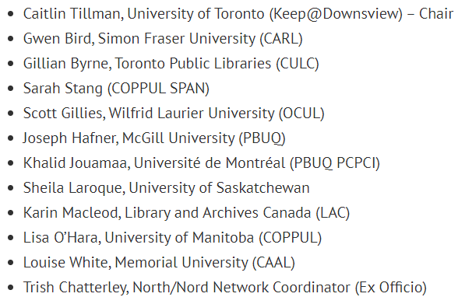
Steering Committee

Slide 7
Library Participation in North/Nord
Program Level
Archive Builder & Archive Holder
Archive Holder
Archive Supporter
Project Level
By invitation for current projects
Flexibility to choose in future
Open to hearing ideas about future projects
Link to our Participant Agreement
Entente de Participation

Slide 8
North/Nord Members
Library and Archives Canada
Bibliothèque et Archives nationales du Québec
Federal Science Libraries Network
Ottawa Public Library
Toronto Public Library
Brock University
Carleton University
Concordia University
McGill University
McMaster University
Memorial University
Queen’s University
Simon Fraser University
Université Laval
Université de Montréal
University of Alberta
University of British Columbia
University of Calgary
University of Manitoba
University of Ottawa
University of Regina
University of Saskatchewan
University of Toronto
University of Victoria
Vancouver Island University
Western University
Wilfrid Laurier University
Notes:
27 participating libraries to date. Not all members have yet participated in the specific projects.

Slide 9
Government Documents

Slide 10
Widely Held Monographs from the NOS study
17 of original 26 libraries from the NOS study are participating
Consolidating holdings at LAC/BAC and at the Downsview facility at the UofT for K@D libraries
Assigning 25 year retention commitments on multiple copies (N=5) of widely held (>3 holdings across NOS study participants) monographs
Widely held list = ~77,000 titles
Pilot list = ~2100 titles
Phase II = ~ 5500 titles
Phase III = ~10,000 titles (Assigned but not yet communicated)
Once retention commitments are confirmed, title lists will be posted to the North/Nord website
List of stable repositories of Canadian Gov Docs

Slide 11
Next Steps re: Gov Docs
Phase IV list (items with 6-9 holdings across NOS participants) - ~15K items
Phase V list (items with 4 or 5 holdings across NOS participants) - ~20K items
List of titles ‘Not at LAC’
Retention re-allocations across the Phases
Then…
Widely Held Serials!

Slide 12
Indigenous Works Stream
Sheila Laroque, July 12, 2023

Slide 13
Statement of Intention
Along with a Land Acknowledgement, this statement of intention outlines our commitment to engagement, listening and learning, and collaboration. Our intention with this shared print program is to prioritize and build upon relationships with our partners first. Without our project partners and our relationships current and future, we would not be able to conduct our work. We commit for this project to be a discussion, a call for collaboration, a chance to rethink the colonial structures embedded within Shared Print practices to date. Our ideas of how this work might be done will evolve based on what we hear from our partners and the communities we hope to work with. Learning about how we can work collaboratively is our first priority as we listen to new ideas around access and stewardship for shared print.
Notes:
Rather than ubiquitous land acknowledgment (aka Air Canada) - felt it was more pertinent to let people know the intentions of the overall project rather than where particular folks are situated. This is what I have been taught about Land Acknowledgments - the intention is to introduce ourselves to the land and what we are up too, not just acknowledging the where of the land but more so the “what” we hope to accomplish, and our intentions to move forward in a Good Way

Slide 14
Student Projects
Who has been creating and publishing Indigenous Works?
Jillian Metchooyeah - List of Canadian Indigenous Publishers and Organizations
Laura Reid - expanding COPPUL’s Indigenous Canadian Historical Serial Publications Dataset to include Indigenous periodicals from Eastern Canada
Notes:
Environmental Scan works - answering the questions of what are we dealing with? What might be considered an Indigenous Work and who would have created them? - answers we attempted to answer with Jillian’s work. This is available on the North/Nord website under Projects > Indigenous Works.
Laura Reid’s work with COPPUL - furthering the data gathering on periodicals (Indigenous newspapers).

Slide 15
NIKLA-ANCLA
National Indigenous Knowledge and Language & Alliance | Alliance nationale des connaissances et des langues autochtones
https://www.nikla-ancla.com/
Notes:
In brainstorming who we should connect with - Feather Maracle CEO of Six Nations Public Library - suggested we join NIKLA. So we did! They are also revamping their organization; and we are confident that we will be able to strengthen the work of the Alliance, and find other partners through the Alliance who are also looking for project partners.

Slide 16
Language Materials?
Carving out our space - the post-digitization phase. Can materials be shared or returned?
Scope of shared print.
Is our role connecting digitization projects with libraries that contain print materials?
Notes:
Scope creep - what would a shared print approach to language learning materials look like? Where can our space be within any potential projects? Audio files and translation aspects can potentially be part of language learning materials, but we don’t necessarily need to reinvent the wheel on that. Rather supporting other partners who are doing the work with the component of Shared Print that we could bring to the table seems like a more sustainable start.

Slide 17
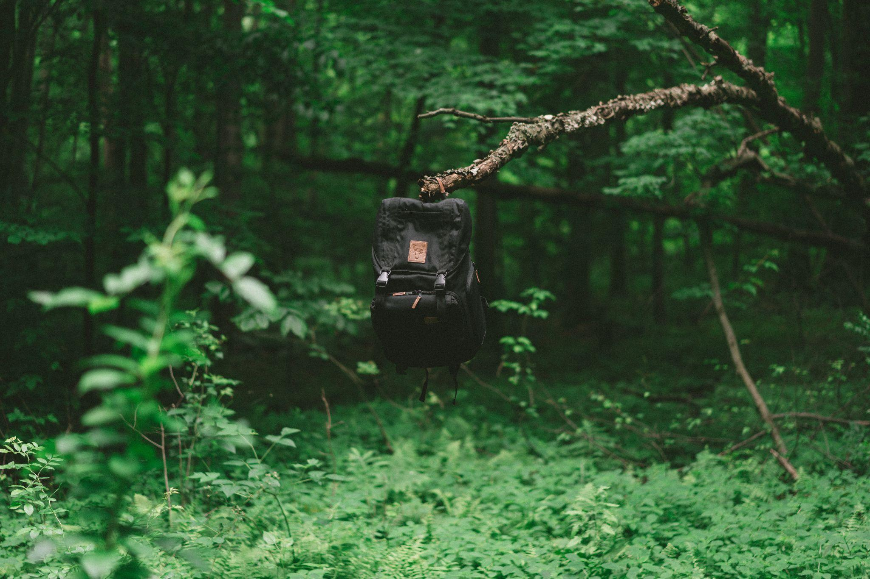
Catching Up the Catalogue
Photo by Keagan Henman on Unsplash
Notes:
Lost in the weeds. Search on Unsplash. This is actually a great metaphor for us. It’s a backpack hanging from a branch in the tree. We have an idea of where we are going, perhaps we will fill our backpack with tools and expertise that we bring from our visits and partnerships with others, and we will gain more skills and partners along the way.
Before we can implement a full project with records analysis - we need to recognize that cataloguing for Indigenous materials - particularly language materials has been spotty at best. So we are interested in hearing more about potential successes and wins; or strategies that institutions might have in finding and accurately displaying what is in their own catalogues.
Not just books; relationships. What do we have and what partnerships can we build up and strengthen in order to do something new?

Slide 18
Canadiana

Slide 19
Canadian University Press Project
17 libraries participating
Marc extracts have been loaded into Gold Rush
Awaiting final indexing before diving into the overlap analysis
Metadata messiness - a common problem to overcome!
To be distributed soon - a survey about prospective print collecting of your own Institutional Press’s publications
Aim to complete the project by December
Planning for the next project

Slide 20
Program Evaluation - Focus Groups
Technical services cluster: Tuesday, July 18 OR Wednesday, August 2
Collections cluster: Wednesday, July 19 OR Thursday, August 3
AUL/Admin cluster: Thursday, July 20 OR Tuesday, August 1

Slide 21
Presentations
Print Archive Network Forum at ALA Annual 2023
Workshop on Retention Statements - Wednesday, September 27th, 2023 at 11am PT
Workshop on Weeding - January 2024, exact date TBD
Workshop on Collection Analysis - May 2024, exact date TBD

Slide 22
We invite your feedback!
Please submit your recommendations or questions to us via this Google form (can be anonymous) or directly via email to north.nord.sharedprint@gmail.com
Notes:
https://docs.google.com/forms/d/e/1FAIpQLSdXw5OuXw7FaVHt7xYiVBL0caQrWfSlTwirkqTkACbVC9L8vg/viewform

Slide 23
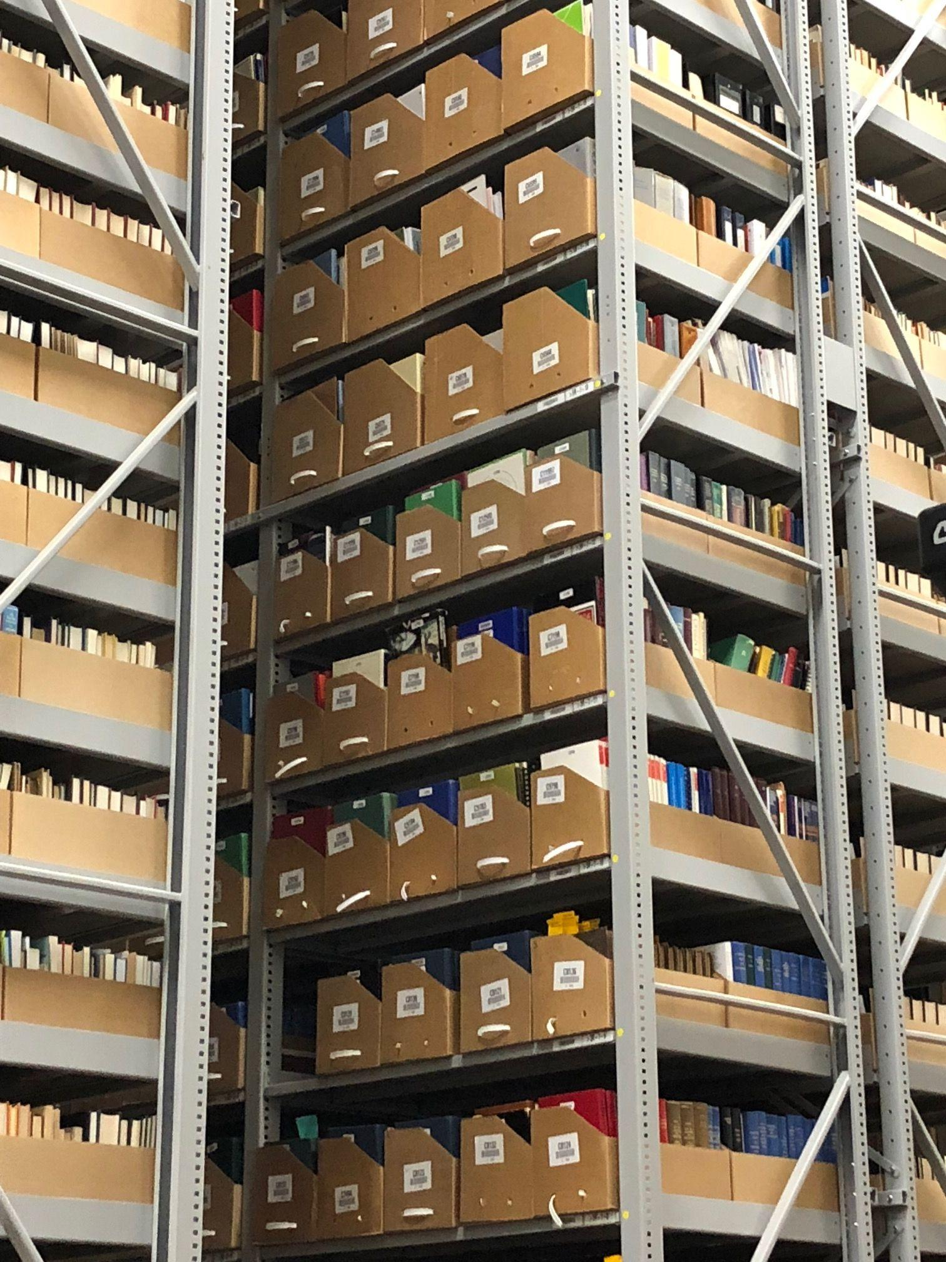
Questions? Comments?
Sheila Laroque - sheila.laroque@usask.ca
Trish Chatterley - north.nord.sharedprint@gmail.com

Slide 24






Thank you to our funders!

