Slide 1




Networks of Trust: Institutional Interoperability through Shared Print Programs
Superconference, Ontario Library Association, January 2026
Programs
COPPUL SPAN
Jean Blackburn
Keep@Downsview
Kyla Everall
Partenariat des bibliothèques universitaires du Québec
Meredith Giffin
North/Nord
Katya Pereyaslavska
Notes:
We are grateful to speak to you today in Tkaronto, the traditional territory of many nations including the Mississaugas of the Credit, the Anishnabeg, the Chippewa, the Haudenosaunee and the Wendat peoples, and home to many diverse First Nations, Inuit and Métis peoples.
Keep questions towards the end

Slide 2

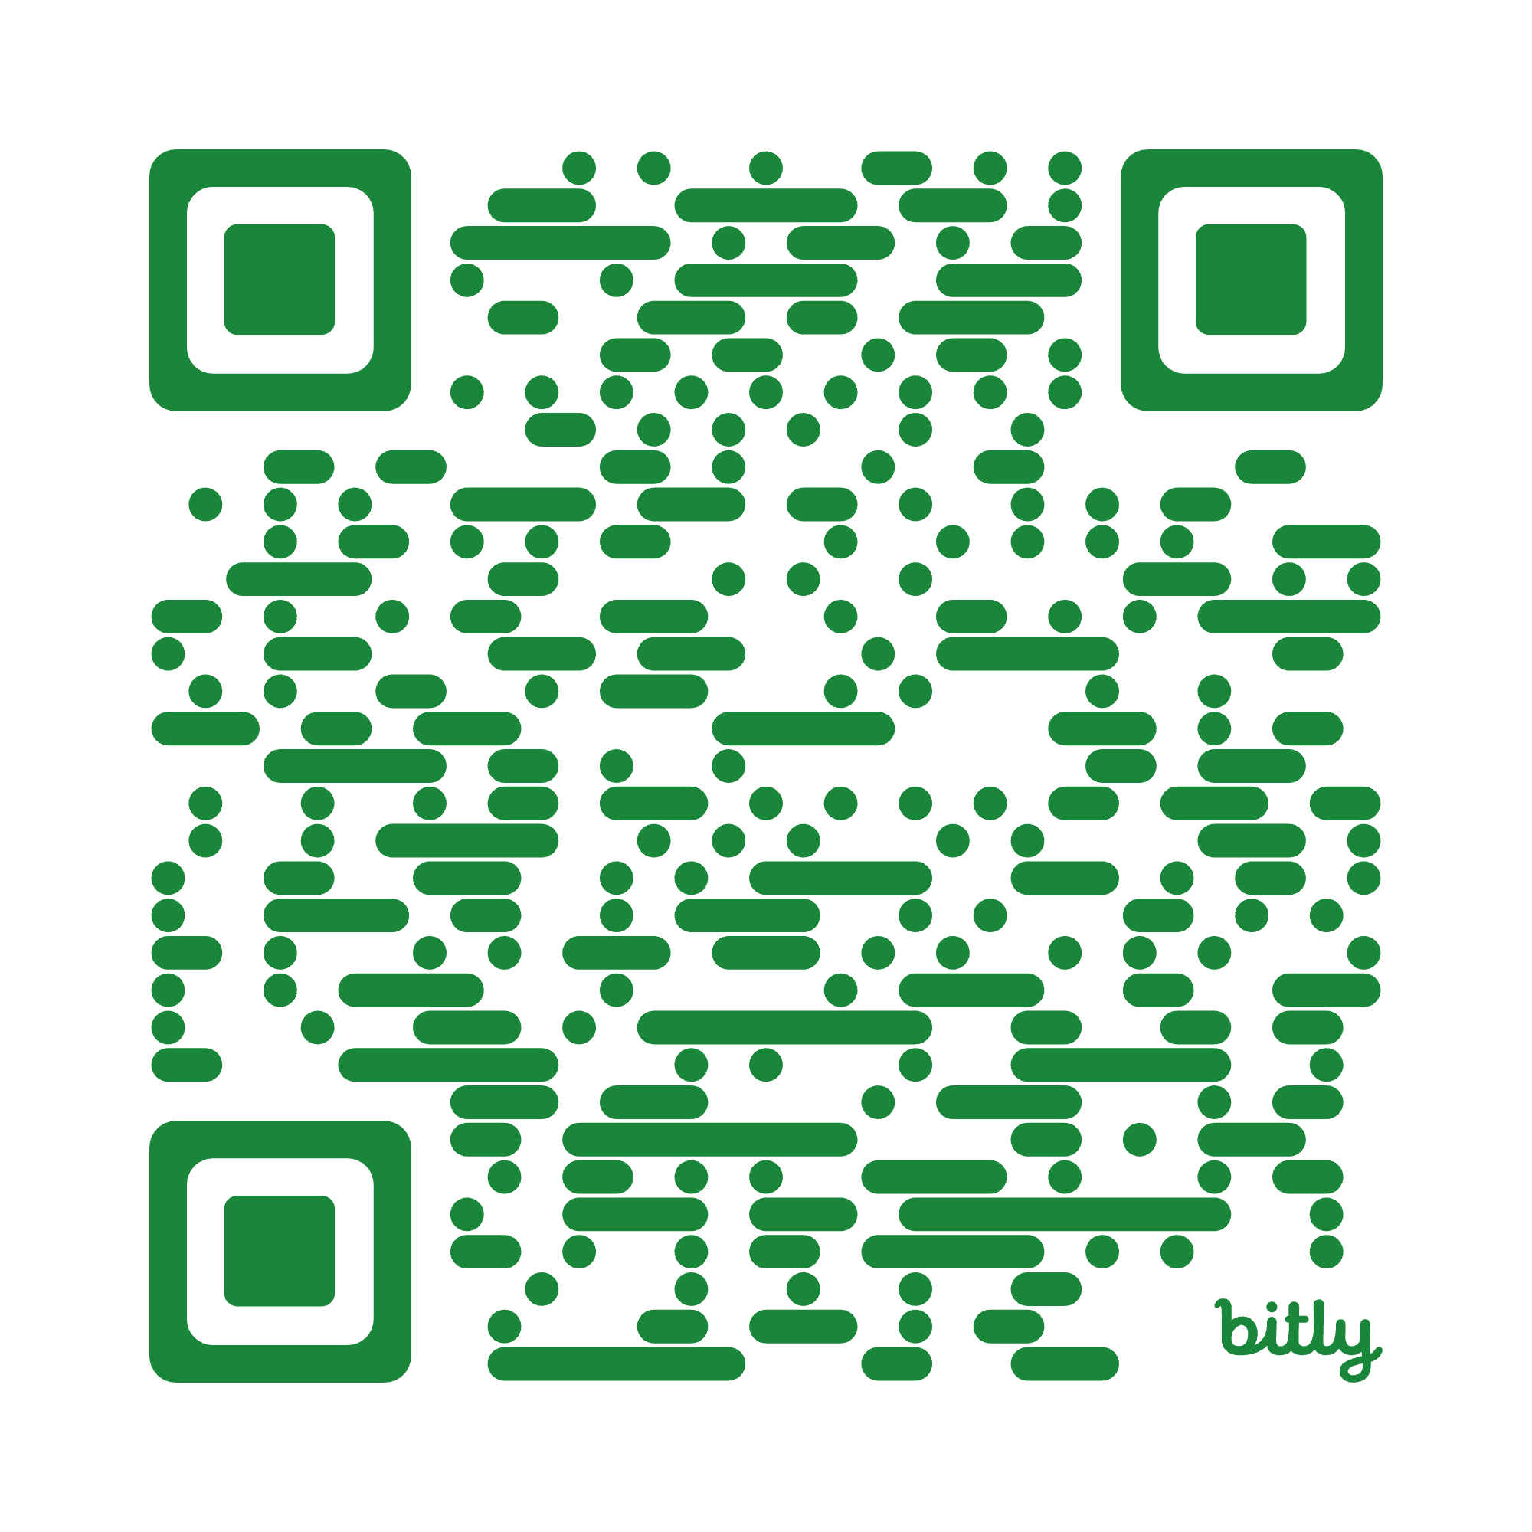
Introducing Our Programs
COPPUL SPAN
Keep@Downview
PBUQ
North/Nord
Notes:
Program basics
When they started
Membership
Format - distributed or facility-based

Slide 3

COPPUL Shared Print Archive Network (SPAN)
SPAN Phases to date:
Widely held, low-risk journals (PCA)
Medium--risk journals (less widely held, PCA or no PCA, Canadian journals)
High-risk journals (only in print)
Statistics Canada publications
At-Risk Western Canadian Serials*
Western Topographic Maps
  1:63,360 and 1:25,000 National Topographic System series
Rarely-held & regional-interest monographs
  10 participating libraries
  Consensus retention model
Est. 2012
23 member libraries across MB, SK, AB & BC
Opt-in (separate fee schedule)
Governed by standing committee & staffed by part-time coordinator
Retrospective…so far
Distributed
Goals:
  Access to shared print archives
  Cost-effective preservation of the print record
  Creation of opportunities reallocating library space
Notes:
* closed-stack retention required; shelf validation

Slide 4

Keep@Downsview
Program basics
Established in 2014
5 members + 1 associate member
Facility-based shared print program that operates out of UTL@Downsview
Over 200,00 items in our shared collection
Partners can participate in 2 ways:
Send unique material to Downsview facility
Share ownership of material that is already there (and discard their local copy)
20 year retention commitment
Access via ILL request
https://downsviewkeep.org/
Collection criteria
Library driven: partners identify material that they’d like to transfer that meets core criteria – unique, low-use, catalogued
New ways of working
Exploring partner-proposed transfers from U of T Libraries to Downsview
Collaborating on N/N commitments
Collective metadata enhancement
Digitization strategy
Communication plan

Slide 5

Programme de conservation partagée des collections imprimées /
Shared Print Preservation Program
15 French, 3 English universities
Program phases:
  2021: Project launch; contract with OCLC’s GreenGlass
  2022: Print book distribution model & 25-year Memorandum of Understanding adopted
  2023: Book retention commitments added in WMS
  2024: Print serial distribution model adopted; serial retention commitments added in WMS
Circulating print books: 1,910,000 titles
  Also includes government documents, music scores and children’s books
  Canadian publications + high-use, relatively rare titles published elsewhere
Canadian serials: 27,909 titles
Distributed model: each institution retains items in their own collections

Slide 6
North: the Canadian Shared Print Network/ Nord: Réseau canadien de conservation partagée des documents imprimés
Funded By:
Canadian Association of Research Libraries (CARL) – https://www.carl-abrc.ca/
Canadian Urban Libraries Council (CULC) – https://culc.ca/
Council of Atlantic Academic Libraries (CAAL) – https://caal.libcal.com/
Council of Prairie and Pacific University Libraries (COPPUL) – https://www.coppul.ca/ (Hosting org.)
Library and Archives Canada (LAC) – https://www.bac-lac.gc.ca/
Ontario Council of University Libraries (OCUL) – https://ocul.on.ca/
Partenariat des bibliothèques universitaires du Québec (PBUQ) https://pbuq.ca/
Founded in 2021
GreenGlass Analysis to get us started
Distributed Model
Governed by a Steering Committee & staffed by a Network Coordinator and Data Analysts
Work is organized by projects with a specific focus:
  Canadian University Presses
  Indigenous Works
  Government Documents
  1:50k Topo maps
  Researcher in Residence (inaugural year)
  Digital Alignment
Coordination with regional & international shared print programs (Hathi Trust, West, East, EPICo, SPP etc)
https://northnordsharedprint.ca/

Slide 7

Operational Frameworks & Collective Actions
Notes:
How do we collaborate and get work done?
What institutions/networks are getting out of it?
Decisions around what projects look like?
Consensus building

Slide 8
Operational Frameworks
& Collective Actions
Context for SPAN Genesis
History of trust & collaboration
Enrollment trends & space constraints
Print usage declining
Shared print projects at scale (CRL)
National ‘last copy’ discussion (LAC) & “optimal copy” model (ITHAKA)
Governance & Participation
5--year renewable membership agreement, modest fees
Standing committee composed by role as well as region & institution size/mandate
Participation
Opt-in project proposals
Commitment, not consensus*
Archive Supporters, Builders & Holders
Retention periods of 10 to 25 years
All SPAN members benefit from all phases
Standard notes in 583 field
Commitments registered in PAPR and OCLC Shared Print Registry
Processes such as shelf verification & condition assessment vary by project goals
* SPAN Monograph Project governed by separate committee composed of representatives from each participating library; retention model & associated processes designed by consensus
Notes:
Long tradition of resource sharing:
ILL, discovery systems, e-licensing, digital archiving, pooling assets and technologies to solve problems
Context for SPAN genesis - enrollment numbers increasing & libraries crowded & outgrown; print usage declining (espec. Serials at that time) ; shared print projects reaching scale (CRL) Different landscapes, economies
Different regional interests
Different governments
national ‘last copy’ discussion in Library & Archives Canada & “optimal copy” model suggested by ITHAKA
history of trusted relationships
continue building on what we have
kept it simple, practical, low-risk
driving goal was space repurposing rather
than collection management protocols
Distributed model more important when dealing with rare and hyper-local materials - holding libraries do not want to have these materials removed from their collections
Contributes to trust among COPPUL members which in turn supports other initiatives

Slide 9
Operational Frameworks
& Collective Actions
Operational Framework & Participation
Steering Committee: provides leadership and oversight
Coordinating Committee: makes recommendations to Steering Committee on strategic and operational aspects
Sub-committees and working groups: for areas of on-going concern or ad hoc projects
Day to day operations: managed by UTL
Strategic Directions & Initiatives: Guiding document that provides framework for work of Coordinating Committee
Goal
To create preservation positive access to shared-collection of importance to Canadian scholars
Benefits for partners
Preserving long-term access to research collections
Working collaboratively to develop responses to common local problems
Partners able to regain space to respond to changing priorities and needs

Slide 10

Operational Frameworks
& Collective Actions
Framework
Existing consortial collaboration: ILL, WMS
Shared Print Preservation Executive Committee
Establish goals, direction, projects
Approve recommendations
Formalize agreements
Program Chair
Lead Advisory & Working Groups
Report to Executive Committee
Manage ongoing program activities
Advisory Group
Determine scope for projects
Work with GreenGlass and other tools to establish retention models
Make program recommendations
Working Group (all institutions)
Provide and update data
Share issues, solutions, strategies
Goals
Ensuring preservation of Canadiana, Laurentiana, and high-use/rare items
Formalizing an agreement with all members participating
Determining preservation commitments according to institutional needs, size and resources
Complementing other Canadian preservation initiatives
Ensuring user access to print materials across the consortium
Supporting library space optimization
https://libguides.pbuq.ca/gtcp

Slide 11
Operational Frameworks
& Collective Actions
Our work is done through a mix of formal governance, shared infrastructure, and clearly divided responsibilities.
Steering Committee reviews & signs off on project proposals
Value Proposition for member institutions
Diversifying projects to expand on our offerings
Incorporating elements of solving broader collection issues
Working Groups operationalize projects
Metadata expertise
Collections expertise
Subject matter expertise
Partnership Agreements
Outline specific responsibilities & formalize activities
Consensus building
Utilizing consortial networks to build on existing pathways and trusted relationship to advance this work;
Distributed responsibility - work is shared rather than pooled into a single institution.
How do we collaborate and get work done?
Working Groups
Networks & partnerships
North/Nord creates value across a diverse ecosystem of institutions and networks.
benefit through applied collaboration, knowledge exchange;
increased visibility, cross-sector partnerships, and access to new audiences;
innovation pipelines (ie collection analysis workflows), talent engagement, and insights grounded in both local and international perspectives.
networks gain strengthened connections, shared resources, and scalable models that support long-term impact and sustainability.
national-level coordination to identify and retain collections (scarce and widely available).

Slide 12

Opportunities & Challenges
Notes:
How do we collaborate and get work done?
What institutions/networks are getting out of it?
Decisions around what projects look like?
Consensus building

Slide 13
Opportunities & Challenges
Opportunities
Reinforcement of trust relationships, interdependence & community - beyond transactional value
Stewardship of regionally relevant materials
Intersections with other COPPUL programs
Illumination of local collections
Monograph project expansion
Respectful care for Indigenous works
Prospective shared print archiving
Digital alignment
Challenges
Lack of shared LSP or union catalogue
Metadata quality & consistency
Cost-effective, vendor-agnostic collections analysis tools
Institutional capacity
Program capacity
Buy-in and decision-making across diverse membership
Commitments wane with time & staff turnover
Shifts in resource sharing landscape
Communicating value
Discovery

Slide 14
Opportunities and Challenges
Opportunities
Work with LSP vendor to develop and improve collective collection tools
Work collaboratively to solve sticky problems and build skills
Better articulate benefits of shared collections
Support and contribute to development of Ontario collaborative collection programs
Collaborative digitization
Challenges
Systems not built for Shared Print (SP)
Collection analysis tools
Metadata
Maintaining institutional knowledge
Embedding SP into collection lifecycle
Duplicated efforts across SP programs
Capacity

Slide 15
Opportunities and Challenges
Opportunities
Shared library platform implementation grant enabled consortial GreenGlass licensing
Collaboration on WMS migration facilitated inter-institutional teamwork
GreenGlass data assists individual institutions with collection assessment
Determining perpetual access ejournal holdings assists individual library weeding
Canadian print serials analysis enabled gaps in retained runs to be completed by other libraries
Future shared print storage
Challenges
French + English
18 universities of diverse size, mission, location
All-in participation by consortial members
Tension between goals of print preservation and library space optimization
GreenGlass serials product not designed for consortial analysis
Metadata! English vs. French records in WorldCat, variable loans data, inconsistent serial holdings, inventory control
Institutional capacity and university budget issues in Québec

Slide 16
Opportunities & Challenges
Opportunities
Expand the scope of shared print by experimenting with new formats and embedding one to two persistent library challenges into each project, generating solutions that benefit the collective.
New Solutions: to build on work developed by partner organizations, enabling the ongoing refinement and scaling of effective solutions and workflows.
Connect: surface areas of shared need, foster collaboration, and open these conversations at a national scale.
Work towards alignment of digital and print as well as culturally sensitive approaches.
Challenges
Metadata: regardless of whether we rely on GreenGlass or develop inhouse collection analysis solutions, inconsistent metadata will continue to cause issues when de-duplicating records and working with collections.
Capacity: aligning long-term retention commitments with evolving member priorities and capacity constraints.
Sustainability: securing sustainable funding and staffing models that support shared print work beyond 3-year cycles.

Slide 17

The Big Picture
Notes:
Shared Print solving risks for future libraries
Data Sovereignty
Climate Change (UN SDGs)
Digitization - transformative access (CDL); Shared Print as a foundational preservation layer
New model for networked library system
Libraries as coordinators not just collectors - shared print as extension of resource sharing, improving access to research materials

Slide 18
The Big Picture
Global Cooperation & Collective Stewardship
Cooperation beyond borders, positioning shared print programs as interconnected nodes within an optimal-copies network
Securing internationally visible shared print commitments to understand shared risks, reduce unnecessary duplication, and strengthen collective stewardship of the global print record
Knowledge Stewardship, Sovereignty & Ethics
Stewardship at local, regional, and national levels, with attention to cultural sovereignty and responsibility
Addressing bias in collections through improved metadata practices and more inclusive descriptive frameworks
Grappling with the question: if shared print archives are the special collections of the future, how do we make principled, transparent decisions about what not to retain?
Notes:
LAC, CCDH, Canadiana, Shared Print Partnership
vendor-agnostic and cost-effective collaborative
collections analysis mechanisms - CCLP prototype
Jean’s notes
Cooperation beyond borders: shared print programs as nodes in an optimal copies network
Knowledge stewardship & sovereignty: local, regional & national
Metadata improvements & addressing bias in collections
Digital corollaries to shared print retentions, shared print corollaries to digitized works,
AI & computational research
If shared print archives are the “special collections of the future”, how do we decide what not to keep?
Discovery & analysis tool development

Slide 19
The Big Picture
Standards, Alignment & Interoperability
Developing and adopting shared standards and frameworks that enable alignment, interoperability, and coordinated decision-making across shared print initiatives
Discovery, Access & Preservation
Balancing long-term retention commitments with equitable, reliable access to ensure shared print remains both durable and usable
Advancing discovery and analysis tools that surface shared print commitments and support evidence-based decision-making
Digital–Print Integration & Research
Exploring digital corollaries to shared print retention and shared print corollaries to digitized works
Enabling AI-driven and computational research that leverages shared print and digitized collections in complementary ways
Notes:
LAC, CCDH, Canadiana, Shared Print Partnership
vendor-agnostic and cost-effective collaborative
collections analysis mechanisms - CCLP prototype

Slide 20
The Big Picture
Technology, Innovation & Infrastructure
Investigating technology opportunities that improve coordination, analysis, and access across shared print programs
Using shared print as a space for experimentation with new models, tools, and collaborative approaches and as a counterweight to fragmentation (distributed custody reduces risk political pressure, funding cuts, or policy shifts)
Program-Level Strategy, Impact & Advocacy
Leveraging and connecting work already underway across organizations to accelerate the development of reusable solutions and workflows
Amplifying visibility and impact by clearly communicating shared print commitments, outcomes, and value to funders, partners, and the broader library community
Notes:
LAC, CCDH, Canadiana, Shared Print Partnership
vendor-agnostic and cost-effective collaborative
collections analysis mechanisms - CCLP prototype

Slide 21
Thank you!
Q&A Period

