Slide 1
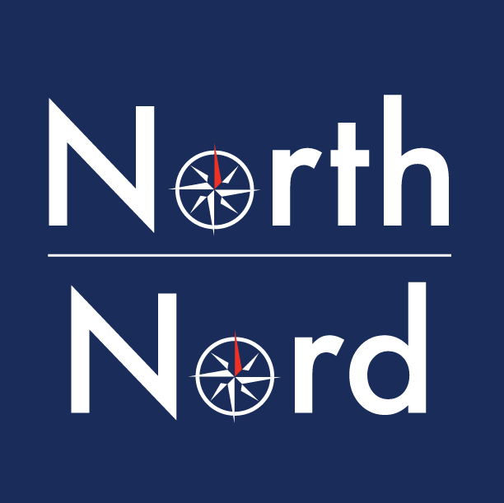
Strengthening Access, Honouring Knowledge:
North/Nord Shared Print Strategies for Indigenous Materials
OLA Super Conference
January 30, 2026
North: the Canadian Shared Print Network/
Nord: Réseau canadien de conservation partagée des documents imprimés
Notes:
Katya: Intro

Slide 2
Speakers
Katya Pereyaslavska
Coordinator, Span & North/Nord
Jennifer Browning
Carleton University Library
Chair, Indigenous Works Subgroup
Researcher-in-Residence, North/Nord (2025/26)
Juliya Borie
University of Toronto Libraries
Erin Bourgard
Western University Libraries
Matt Fesnak
McMaster University Library
North: the Canadian Shared Print Network/
Nord: Réseau canadien de conservation partagée des documents imprimés
Notes:
Katya: Intro

Slide 3
The Vision for Shared Collections Across North America
What is shared print?
“Shared print is the practice whereby a group of libraries share responsibility for managing print materials. This will include a commitment to retaining specific materials for an agreed upon period of time” (Shared Print Toolkit, Shared Print Partnership)
“Shared Print” is a misnomer since it isn't limited to printed materials and can include all and any physical collections which libraries hold.
Participation, staffing and governance
There are a lot of common elements across shared print programs in North America and Europe:
Highly collaborative
Collection analysis work
Metadata work & retention notes
Partnership agreements with participants outlining terms of engagement
Some aspects differ:
Reliance on central storage facilities, distributed activities or a hybrid approach
Capacity to tackle broader range of formats
Staffing and associated costs
Benefits
Taking care of collections & protecting them
Improving metadata and discovery of materials that appear to be invisible;
North: the Canadian Shared Print Network/
Nord: Réseau canadien de conservation partagée des documents imprimés
1. Shared Print 101 for New Program Officers
Notes:
Katya - Intro, what is shared print/North

Slide 4
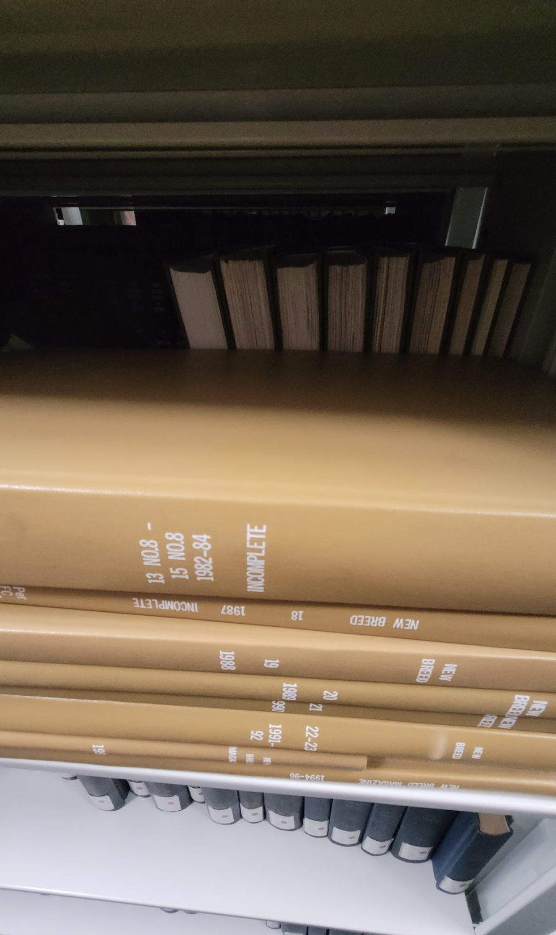
This initiative is different from our previous shared print “projects”
Temporary Stewardship is not well defined in the context of shared print and as such we need to recognize that our activities will take time and reflection to ensure that this work is meaningful.
It can be challenging for even one institution to navigate their own collections and make decisions, let alone working across multiple organizations
Our current work centers on bringing materials back into view, working alongside holding institutions to deepen familiarity with what they steward and to care for these works more thoughtfully. This includes strengthening metadata and reducing the invisibility of these collections, so they can be better understood and valued.
Bound Periodicals, McMaster University Library
Notes:
Katya

Slide 5



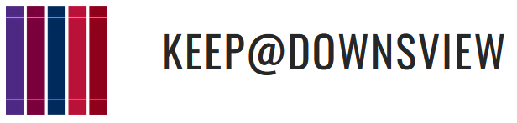



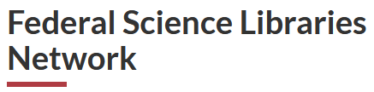

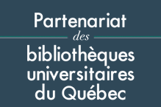






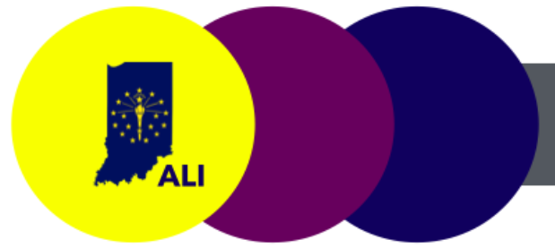
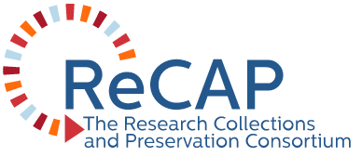
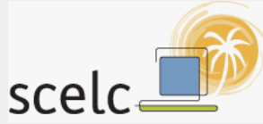
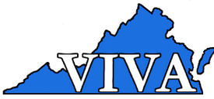





Notes:
Katya

Slide 6
North/Nord Indigenous Historical
Periodical Dataset Project
COPPUL Indigenous Historical Periodicals Working Group
Curated the dataset and performed metadata matching on library holdings across Canada.
Developed a dataset of indigenous periodical publications held across Canadian libraries.
Chaired by Sheila Laroque-Bear who formed subgroup to work with the metadata in the dataset:
What would a scarcity analysis and retention process look like for these types of materials?
What special considerations are needed?
Who to involve?
2) North/Nord Indigenous Works Subgroup
Members initially included OCUL members based on their experience working in collaborative systems and reparative descriptions.
Additional member from U of A recently joined.
Strategize how to work with the metadata (confirming holdings, analysis, scarcity determinations, etc.).
Discuss ethical considerations, balancing preservation with responsible stewardship, community consultation.
Goals of open data, responsible stewardship, equity and sustainability.
Notes:
Jenn

Slide 7
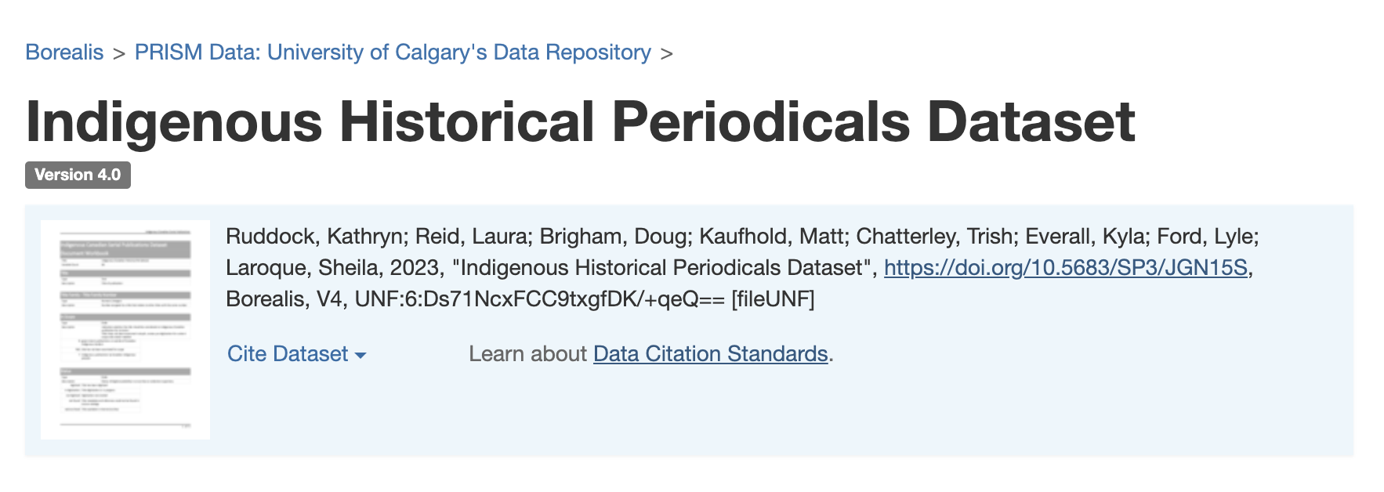

Project Foundations
Notes:
Jenn
COPPUL’s Indigenous Historical Publications Working Group developed a dataset of publications by and about Indigenous communities in western Canada to support preservation and digitization efforts. The first project of the Indigenous Works stream was to expand the dataset across Canada, which was realized through the efforts of Jillian Metchooyeah and Laura Reid. This has now been published as version 3 of the dataset. The focus of North/Nord is print preservation; as such this project will ensure preservation of the original artifacts in libraries across Canada for future study as well as potential repatriation efforts.
This is a listing of Indigenous periodicals (newspapers, newsletters, magazines, and journals), arranged by title. It primarily includes material published in Canada, but also encompasses some titles from American states bordering Canada. The scope aims to include publications by Indigenous communities and organizations, and to exclude known material produced by governments and non-Indigenous organizations. The inventory represents known publications across Canada based on sources from OCLC, and known listings of these publications within the community. All items in the list are held in Canadian libraries, archives, and museums.

Slide 8
Essential Considerations: Ethics, Reconciliation, Equity,
and Sustainability
Ethical considerations: “Position Statement on Ethical Considerations for the Indigenous Historical Periodical Dataset Project”
Land Acknowledgement
Connection to the land and resource-intensive aspect of newspapers
Indigenous Data Sovereignty
CARE Principles and First Nations Principles of OCAP
Open Data repository goals for metadata maintenance
Issue of metadata in proprietary subscription-based platforms
Respectful Terminology and Inclusive Descriptions
Problematic LCSH and OCLC FAST headings
Environmental and Ethical Aspects of Artificial Intelligence
Evaluate use cases. AI does not replace human critical thinking and cataloguing expertise
→ Reparative descriptions and metadata refinement: workshops, augmenting metadata
→ Connecting with Indigenous communities and established groups
→ Preservation and stewardship of these materials compliments these goals. Interconnected themes informs our approach.
Notes:
Jenn

Slide 9
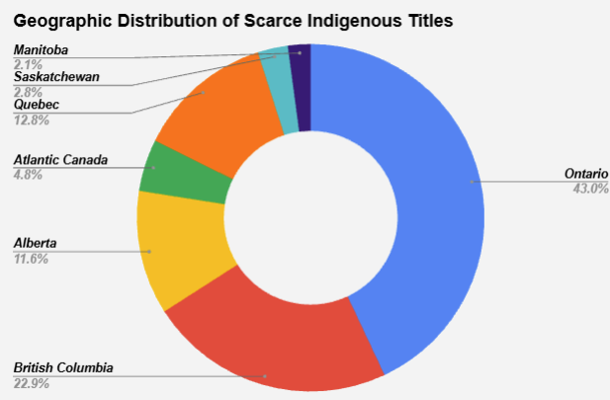
North/Nord Indigenous Historical
Periodical Dataset
Nuances of working with existing metadata
Narrowed initial dataset to existing North/Nord partner libraries
“3-or-fewer” used as qualifier for scarce titles
National distribution but weighted mostly in Alberta, B.C., and Ontario
LAC, UBC, and UAlberta hold approx. 80% of the scarce titles
Notes:
Jenn

Slide 10
Opportunities for Shared Print Collaboration
Collaboration and engagement is a key to successful outcomes and continuity of project
Participation is always voluntary
Review titles lists for their library, starting with “3-or-fewer” titles
Minimum actions encouraged:
Indicate if print versions are found on shelf
Indicate condition
Indicate holdings
To date, 8 of 30 libraries have completed their “3-or-fewer” shelf checks!
Benefits to library participation:
Offers opportunity for libraries participate in a discrete shared print project
Stewardship of important Indigenous collections at local and national scale
Learn how to validate and augment local metadata, improve metadata quality
Benefits to North/Nord:
Enhances national collaboration and library engagement with holdings validation process
Offers insight into common issues with shared print projects that often involve metadata and technology
Case study to refine process for other projects
Notes:
Jenn

Slide 11
Shared Print Collaboration Challenges
Typical challenges for shared print partnerships:
Metadata and technology
Communication
On-going maintenance and stewardship of collections
Determining scope/breadth/types of collections to target
Retention, preservation, digitization and ways of accessing material
These challenges entwine with the important considerations of responsible stewardship, ethics, and reconciliation previously mentioned.
Advantage of many libraries preserving/developing Indigenous collections locally
General consensus about the importance of this project from participants.
Positive interest and prioritization of this project.
Can lead to best practices for other types of shared print projects.
Working with a distributed collection across broad geographic region and types of libraries:
Engaging initially with North/Nord members - diverse representation but where are the gaps?
Differences in local practice – how to unify into shared approach?
Notes:
Jenn: challenges and opportunities of sp. Erin speaks to metadata/systems/tech issues on next slide

Slide 12
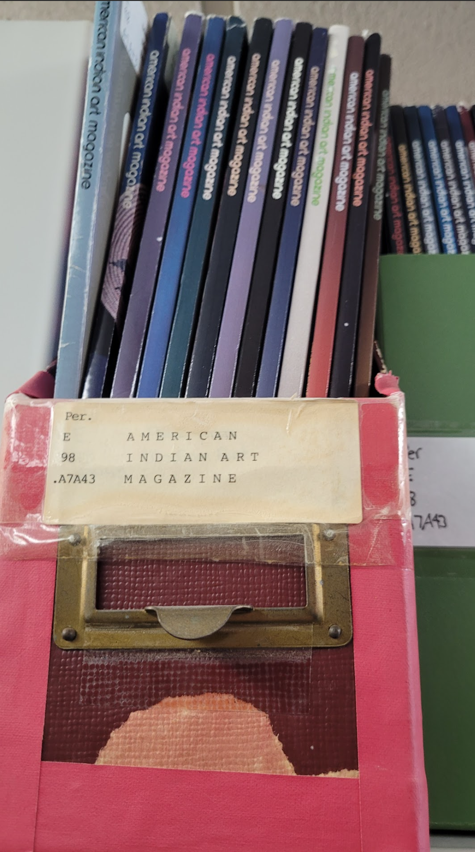
Metadata Challenges in Shared Collections Analysis
Why Comparing Serial Collections is Hard
Serials change over time
(titles, publishers, identifiers)
Exist in multiple formats
(print, online, microfilm)
Libraries describe the same journal differently
Overlap is rarely a simple “yes/no”
American Indian Art - 0362-2630
American Indian Art Magazine - 0192-9968
CONSER - A change in title, once determined, always necessitates a new record, regardless of the choice of main entry.
Notes:
Erin:
This is a project that focuses on periodical publications. When we start working with serials, one of the first things we run into is that they’re just… not stable objects. They don’t behave like monographs where you’ve got one title, one publication, and that’s it. Serials evolve constantly. They change titles, publishers, ISSNs (they split, merge, stop, restart sometimes multiple times). And all of that history ends up reflected in the metadata.
So when we line up collections from multiple libraries, it’s very common to see that two institutions actually have the same journal, but it’s been described in completely different ways. One might be using a newer title, another might have catalogued it years ago under a former title, or they might be describing different formats (print, electronic, microfilm) sometimes all on a single record without making that distinction obvious in the catalogue record. You can easily end up with four or five different “versions” of what is essentially one serial.
Here is an example - American Indian Art Magazine.
This is a publication that was active from 1975 until 2015. Until 1977, the formal name of this publication was American Indian Art (United States), and it used the ISSN 0362-2630
After 1977, the publication adopted the title American Indian Art Magazine. This small change in the title leads to a new ISSN for the periodical - 0192-9968
This small change in title often (but not always) will lead to the creation of a new bibliographic record, and/or a new ISSN
Because of that, overlap analysis is almost never a straightforward yes/no question. It becomes a matter of teasing apart which title, which ISSN, which date range, which format… and understanding that the same thing can look very different across institutions.
And none of that is because anyone made a mistake. It’s just the nature of serials. They’re living things in a way, and the metadata is a record of everything that’s happened to them over time.
Key message: Serials come with built‑in complexity. That complexity doesn’t go away when we compare collections across libraries. It actually gets amplified, and it becomes the foundation of the challenges that follow.
CONSER (Cooperative Online Serials Program)

Slide 13
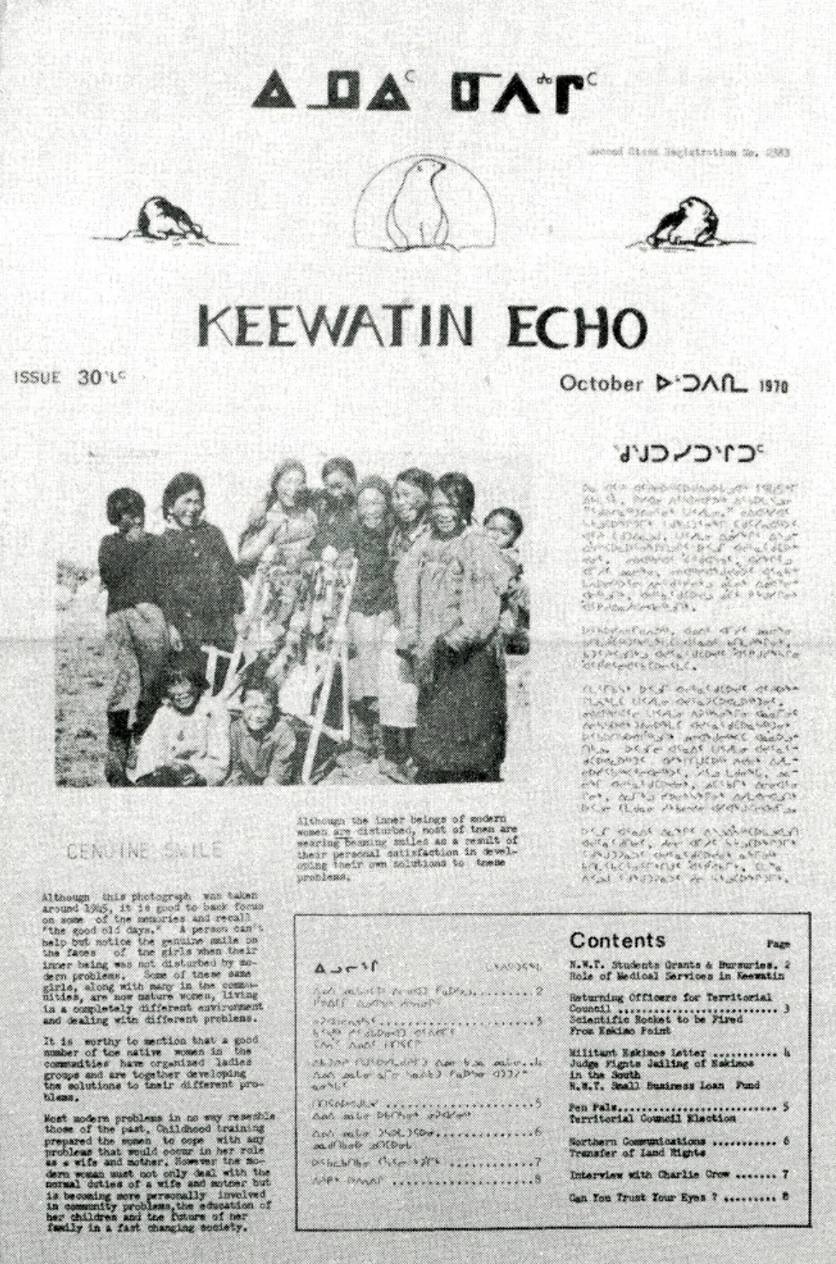
Metadata Challenges in Shared Collections Analysis
Metadata & System Differences Create Extra Challenges
Identifiers can be inconsistent (ISSNs, OCLC numbers)
Holdings data varies by library and system
Older/legacy records may lack identifiers
Dataset is a 2023 snapshot, and collections change
Shelf-checking confirms what’s truly held today
Notes:
Erin:
On top of the complexities built into serials themselves, there are also inconsistencies in the metadata we rely on to match things. Identifiers (ISSNs and OCLC numbers) are supposed to make our lives easier, but sometimes they can introduce their own layer of confusion.
ISSNs, for example, might be missing entirely from older records, or small scale publications such as the Keewatin Echo (first English-Inuktitut newspaper in Canada)
It’s common for print and electronic ISSNs to get mixed, especially when vendor records or legacy practices are involved.
And sometimes publishers reuse ISSNs or apply them in ways that aren’t exactly… helpful.
All of that means you can’t treat an ISSN match as a guaranteed match, other fields need to be analyzed.
OCLC numbers have their quirks too.
Every time a serial changes title, a new record (and a new OCLC number) is eventually created.
OCLC numbers usually contain a prefix, but there are multiple variations of that prefix found in active catalogue records. From a matching standpoint, that means everything has to be normalized before we can even start comparing.
Like ISSNs, we cannot rely on the OCLC number alone as a guaranteed match.
Then we get to holdings data, which is really the heart of item‑level comparison. Holdings tell us what a library actually has (what years, what volumes, what issues).
One library records granular holdings, down to the issue, enumerated; another might use a broad range like “v.1–50” to describe their holdings
Different ILS/LSP systems store metadata in different ways. So libraries follow that. Some use MARC 21 holdings standards; others use local fields, or store details system specific item records.
With this project, item level enumeration gives us the cleanest way to achieve cross-collections item level comparisons.
Final point - we are working from data derived from multiple libraries in Canada that was captured in 2023. This snapshot is incredibly valuable, but it’s exactly that, capturing a moment in time. Collections shift, cataloguing gets updated, gaps get discovered, and items go missing.
That’s why shelf‑checking is such an important part of this project. It grounds the data in reality. It helps confirm whether the item described in our data is actually on the shelf, whether it’s the format we think it is, and whether a “duplicate” is actually the microfilm version disguised in the print versions catalogue record, for example. It enables libraries to validate or challenge the assumptions built into the dataset.
I’ve been focused on metadata challenges as they relate to shared collections analysis. Now I’ll pass it to Juliya and Matt to talk about metadata opportunities and direct actions that we can take to improve metadata, specifically as it relates to a shared collection of Indigenous Historical Periodicals.

Slide 14
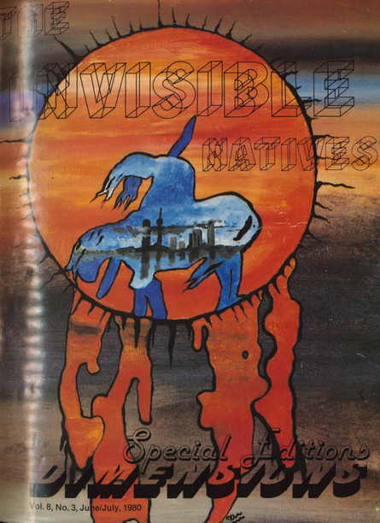
Metadata Opportunities
Holdings metadata
Itemizing holdings to represent items more accurately to strengthen access to materials related to Indigenous Peoples and Knowledges.
creating/enhancing item-level metadata
actionable metadata to facilitate requests collections assessment and print preservation.
Notes:
Juliya
One opportunity for metadata enhancement involves itemizing holdings that were previously described at a high level.
These publications have been cataloged only at the title level, making individual issues, articles, and the Indigenous artists and writers within them essentially invisible to users.
For instance, a researcher looking for art by James Laford that is featured in publications such as Dimensions journal, cannot find them because our records only describe the journal title, not its contents.
Item-level metadata cannot fully capture the beauty of this Indigenous art, but it can at least make these materials findable.
This project prioritizes creating and enhancing item-level metadata. This includes reviewing existing records and identifying gaps or inaccuracies to improve accuracy, completeness, and consistency.
Our goal is not simply better catalog records; it's ensuring that Indigenous creative and intellectual work receives the visibility and respect it deserves, and that Indigenous communities can actually find and access materials relevant to their histories and cultures.

Slide 15
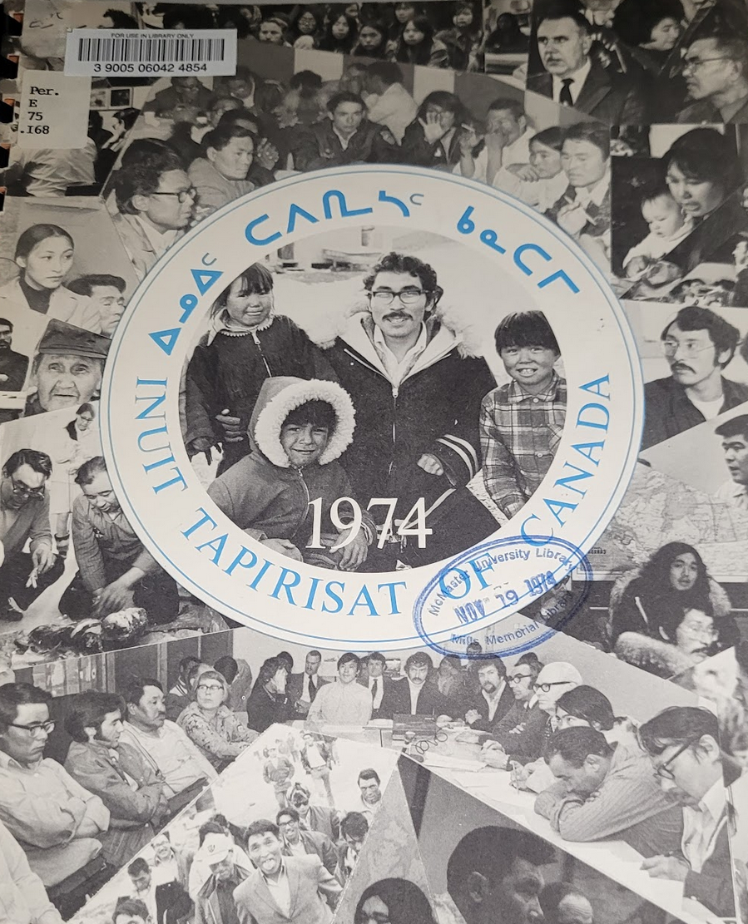
Metadata Opportunities
Opportunities how metadata work can complement broader goals of reconciliation, equity, and sustainability within library practice:
Adding Indigenous syllabics to bibliographic records
Enhancing bibliographic description and discoverability through more granular ISO639-3 language codes
Notes:
Juliya
This work prioritizes Indigenous community needs: finding materials about their nations, locating content in their languages, and seeing those languages represented accurately in library systems.
Many Indigenous languages including Cree, Inuktitut, Ojibwe use syllabic writing systems
We're working with system vendors and libraries across Canada to ensure all Canadian syllabics render accurately in Alma, OCLC, and other platforms. This cross-institutional effort addresses a longstanding barrier: Indigenous language speakers have often encountered garbled characters, question marks, or blank spaces where their languages should appear.
Pairing Syllabics with Enhanced Language Coding
This display work is most effective when combined with granular language identification. By applying specific ISO 639-3 language codes—rather than broad categories like "North American Indian (Other)"—we enable users to search for materials in particular languages. A Cree language speaker can find Cree-language materials; an Inuktitut speaker can find Inuktitut content.
Following Program for Cooperative Cataloging guidance, we include both MARC and ISO 639-3 codes in each record. This dual approach ensures our records work in today's systems (which rely on MARC) while enabling more precise discovery as systems evolve.
Why This Matters
When someone searches for materials in Inuktitut and sees results displayed in syllabics with accurate language codes, several things happen: they can actually read the script their language uses, they can trust that results are genuinely in their language rather than vaguely "Indigenous," and they see their language treated with the same specificity and respect as English or French. This is what linguistic sovereignty looks like in library systems.

Slide 16
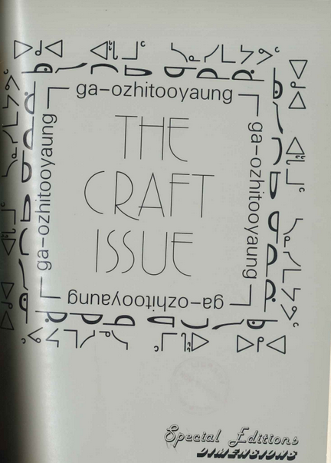
Surfacing Materials in Indigenous Languages
Indigenous Languages are not well represented in MARC standard:
Outdated, inappropriate, and ambiguous terminology
Not all languages are represented (Oji-Cree)
Obscuring of language diversity through collective language codes [1]
Program for Cooperative Cataloguing (PCC) recommends adding additional ISO 639-3 codes (list of 7000 languages)
Can be particularly useful for Indigenous languages that lack specific MARC language codes:
Oji-Cree (ojs)
Mohawk (pending update: Kanien’kéha)
Oneida
Cayuga
Seneca
Onondaga
Tuscarora
[1] https://vimeo.com/952407013
Notes:
Juliya
A key opportunity for improving discovery lies in adopting more granular language codes. We're implementing ISO 639-3 an international standard covering over 7,000 languages in conjunction with the MARC language codes our systems currently require.
Why This Change Is Necessary
My colleagues identified critical problems with Indigenous language representation in MARC that we presented at last year's conference:
Outdated and inappropriate terminology appears throughout MARC language codes and subject headings.
Incomplete coverage leaves many languages entirely unrepresented. Oji-Cree—the fourth most-spoken Indigenous language in Canada, spoken by First Nations communities in northwestern Ontario—has no MARC code. This is the language Sol Mamakwa used when he addressed the Ontario legislature in 2024, the first time it was spoken in that chamber. Yet our cataloging standard has no way to specifically identify it.
Collective codes obscure linguistic diversity. MARC groups Six Nations' languages: Mohawk, Oneida, Onondaga, Cayuga, Seneca, and Tuscarora under a single "Iroquoian" code. ISO 639-3 provides individual codes for each language, finally allowing us to reflect the actual language diversity of the Haudenosaunee Confederacy.
This work is especially urgent because many of these languages are critically endangered.
What ISO 639-3 Offers and Doesn't
ISO 639-3 provides substantially better coverage than MARC, but it's not without problems. More commonly spoken languages are more likely to have dedicated codes. The standard also uses names that don't always match community preferences—for instance, it lists Oji-Cree (code: ojs) as "Severn Ojibwe."
More fundamentally, ISO 639-3 was created by SIL International (formerly Summer Institute of Linguistics), an organization with a complicated missionary and colonial history. The standard relies on Western linguistic frameworks that may not reflect how Indigenous communities understand their own language relationships and boundaries.
Our Pragmatic Approach
Despite these limitations, ISO 639-3 represents a significant practical improvement over MARC's 23 codes for languages
In practice, this means:
Including both MARC and ISO 639-3 codes in our records for system compatibility
Using community-preferred language names in our displays, even when they differ from ISO labels (e.g., "Oji-Cree" rather than "Severn Ojibwe")
Working with the National Indigenous Knowledge and Languages Alliance (NIKLA) to ensure our choices align with community preferences
Advocating for changes to ISO 639-3 itself when it fails to serve Indigenous needs—for example, supporting the proposal to add Kanien'kéha as a recognized name for Mohawk
Immediate Impact on Our Collections
Within our journal holdings, this enhanced language coding allows us to revise records currently labeled with undefined language designations, "unknown Native American script," or overly broad categories like "Eskimo" and "Athapascan." Each of these can now receive specific, accurate language identification.
A Step, Not a Solution
We recognize that truly decolonized description requires ongoing relationships with language communities and responsiveness to their evolving needs. ISO 639-3 is a tool that improves discovery today while we work toward more fundamental change in how library systems represent Indigenous languages. It's a better standard than what we had, but it remains an external standard and we're committed to challenging it when necessary and supplementing it with community knowledge.

Slide 17
Subject Heading Refinement
There are ongoing efforts to decolonize descriptions at individual libraries, through organizations like NIKLA, and amongst library consortia like COPPUL and OCUL.
A “Canadian Cataloguing Task Force” is working on developing “The Collaborative Canadian Catalogue/Le Catalogue canadien collaboratif.”
Maintaining respectful authority files and modified metadata records collectively would be a big benefit for this project.
Notes:
Matt

Slide 18
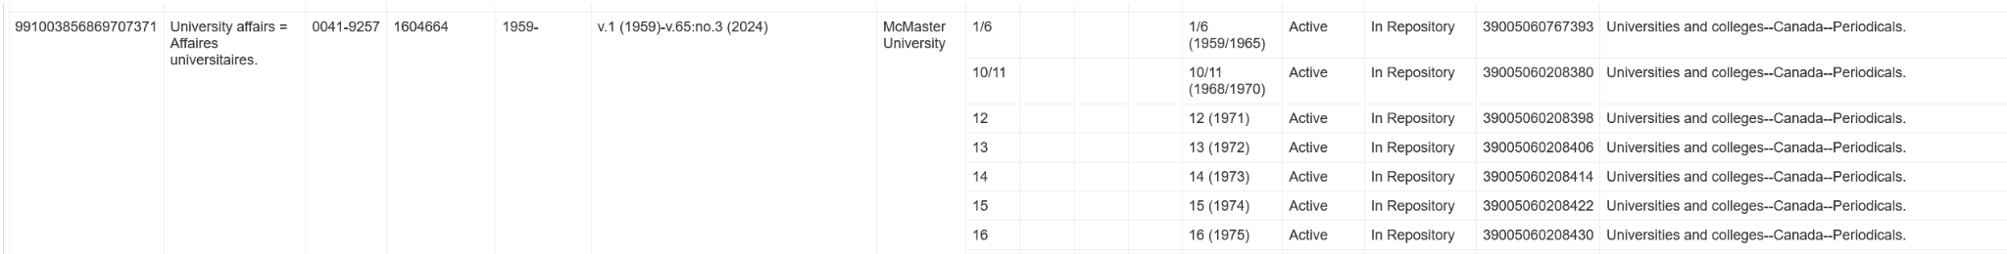
Subject Heading Refinement
Many print periodicals have generic and/or harmful subject headings, and metadata records created before computer- and internet-based catalogues.
Along with adding appropriate language tags, we are considering ways to make these headings more accurate and respectful.
Notes:
Matt

Slide 19
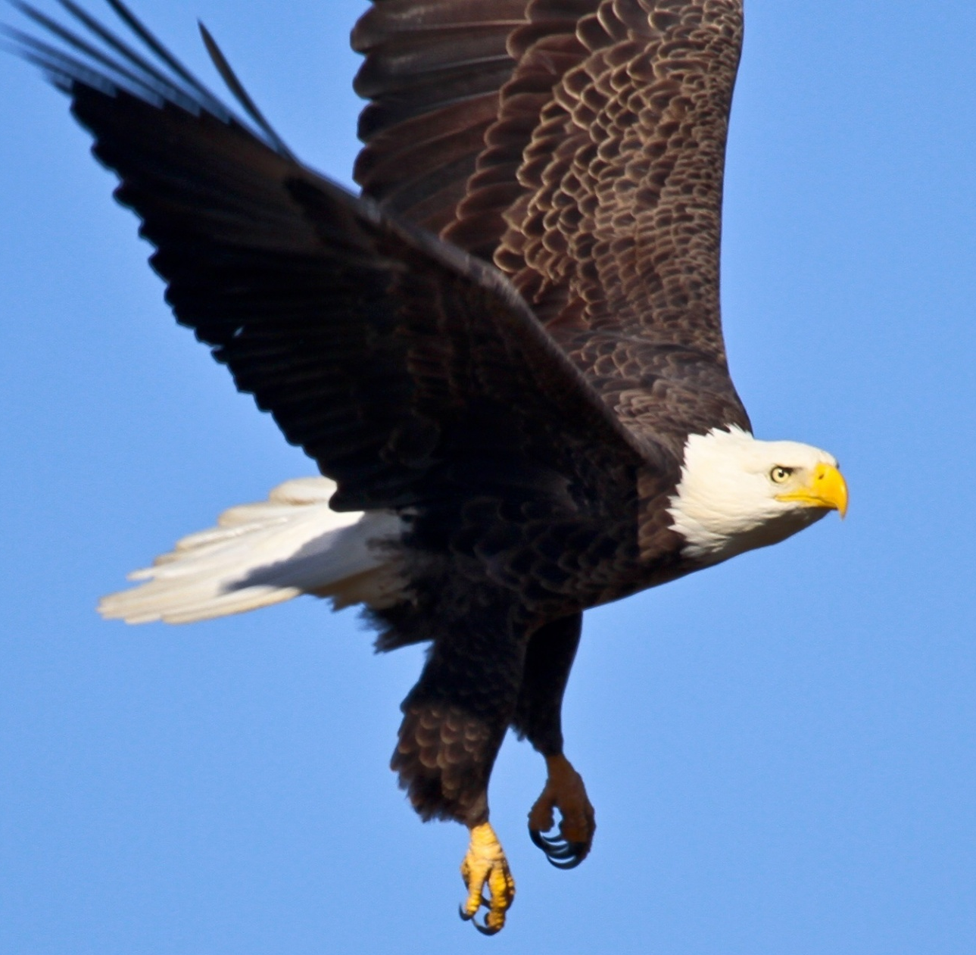
Subject Heading Refinement
In contrast, there are active efforts and decades of history from the Library of Congress and OCLC in the United States that further imperial subject headings and name authorities, and most library systems are built to automatically integrate and prioritize changes made from both organizations.
As such, our project needs to consider hosting records in a place that will not change indigenous-related subjects to Library of Congress’ and OCLC’s preferred terms.
Notes:
Matt

Slide 20
Aspirations
Many existing systems in academia draw resources, knowledge, and wealth from indigenous and non-indigenous communities, and make their resources prohibitively expensive for people to access. Participating in these kinds of relationships is something we all need to be considering critically.
Our goals include creating space - both physical and online - that is welcoming and engaging beyond our individual institutions, especially for the indigenous communities that authored or are discussed in the newspapers and
journals of this collection.
Notes:
Matt

Slide 21
Conclusion & Next Steps
Continue to check-in and support libraries as they work through their title-lists.
Provide support and training opportunities with upcoming holdings and item metadata workshops.
Learning as we go:
Unique project for North/Nord with many interconnected pieces
Continue to adjust and refine approach
Pause and take stock of what we have learned, what we want to do next
Importance of library participation for shelf-checks and metadata validation
Aim to enhance the Borealis dataset and make it available via COPPUL & to incorporate Local Context Labels.
Distinctive project without a roadmap.
Continue learning, listening, engaging.
Connect with other organizations (e.g. NIKLA).
Welcoming other perspectives and ideas from all of you!
Upcoming drop-in workshop - Feb. 18!
Notes:
Jenn

Slide 22
Questions
indigenous-works-subgroup@coppul.ca
North: the Canadian Shared Print Network/
Nord: Réseau canadien de conservation partagée des documents imprimés
Notes:
Katya: questions

Slide 23
Thank You!
With gratitude to our funders for their ongoing support:
Canadian Association of Research Libraries (CARL)
Canadian Urban Libraries Council (CULC)
Council of Atlantic Academic Libraries (CAAL)
Library and Archives Canada (LAC)
Ontario Council of University Libraries (OCUL)
Partenariat des bibliothèques universitaires du Québec (PBUQ)
The Council of Prairie and Pacific University Libraries (COPPUL)
… and a special Thank You to:
Canadiana / CRKN
CRL Shared Print Services
Depository Services Program, Government of Canada
Eastern Academic Scholars’ Trust
European Print Initiatives Collaboration
Hathi Trust
National Indigenous Knowledge & Language Alliance
Shared Print Partnership
UK Distributed Print Book Collection
Western Regional storage Trust
North: the Canadian Shared Print Network/
Nord: Réseau canadien de conservation partagée des documents imprimés
Notes:
Katya: close

