Slide 1

North/Nord National Topographic Series Maps Project
OCUL-GEO Update
April 24, 2026
Francine Berish, Queen’s
Nick Field, U of T
Sarah Reeser, Scholars Portal
North: the Canadian Shared Print Network/
Nord: Réseau canadien de conservation partagée des documents imprimés

Slide 2
The Vision for Shared Collections Across North America
Mission
This project seeks to improve access to, visibility of, and long-term stewardship for three complete sets of the National Topographic Series (NTS) 1:50,000 scale maps, covering print editions produced between the 1950s and 2012.
Goals
Preservation commitments from three institutions to hold these materials until 2050
Shared inventory of NTS 1:50k sheet holdings, tracking which institutions have which sheets, accounting for edition number and gridded/ungridded
Identify and preserve rare sheets
If possible, to digitize some sheets and upload to Canadiana
Secondarily, to gather NRCan catalogues and other materials as they pertain to the publication of NTS 1:50k sheets
North: the Canadian Shared Print Network/
Nord: Réseau canadien de conservation partagée des documents imprimés

Slide 3
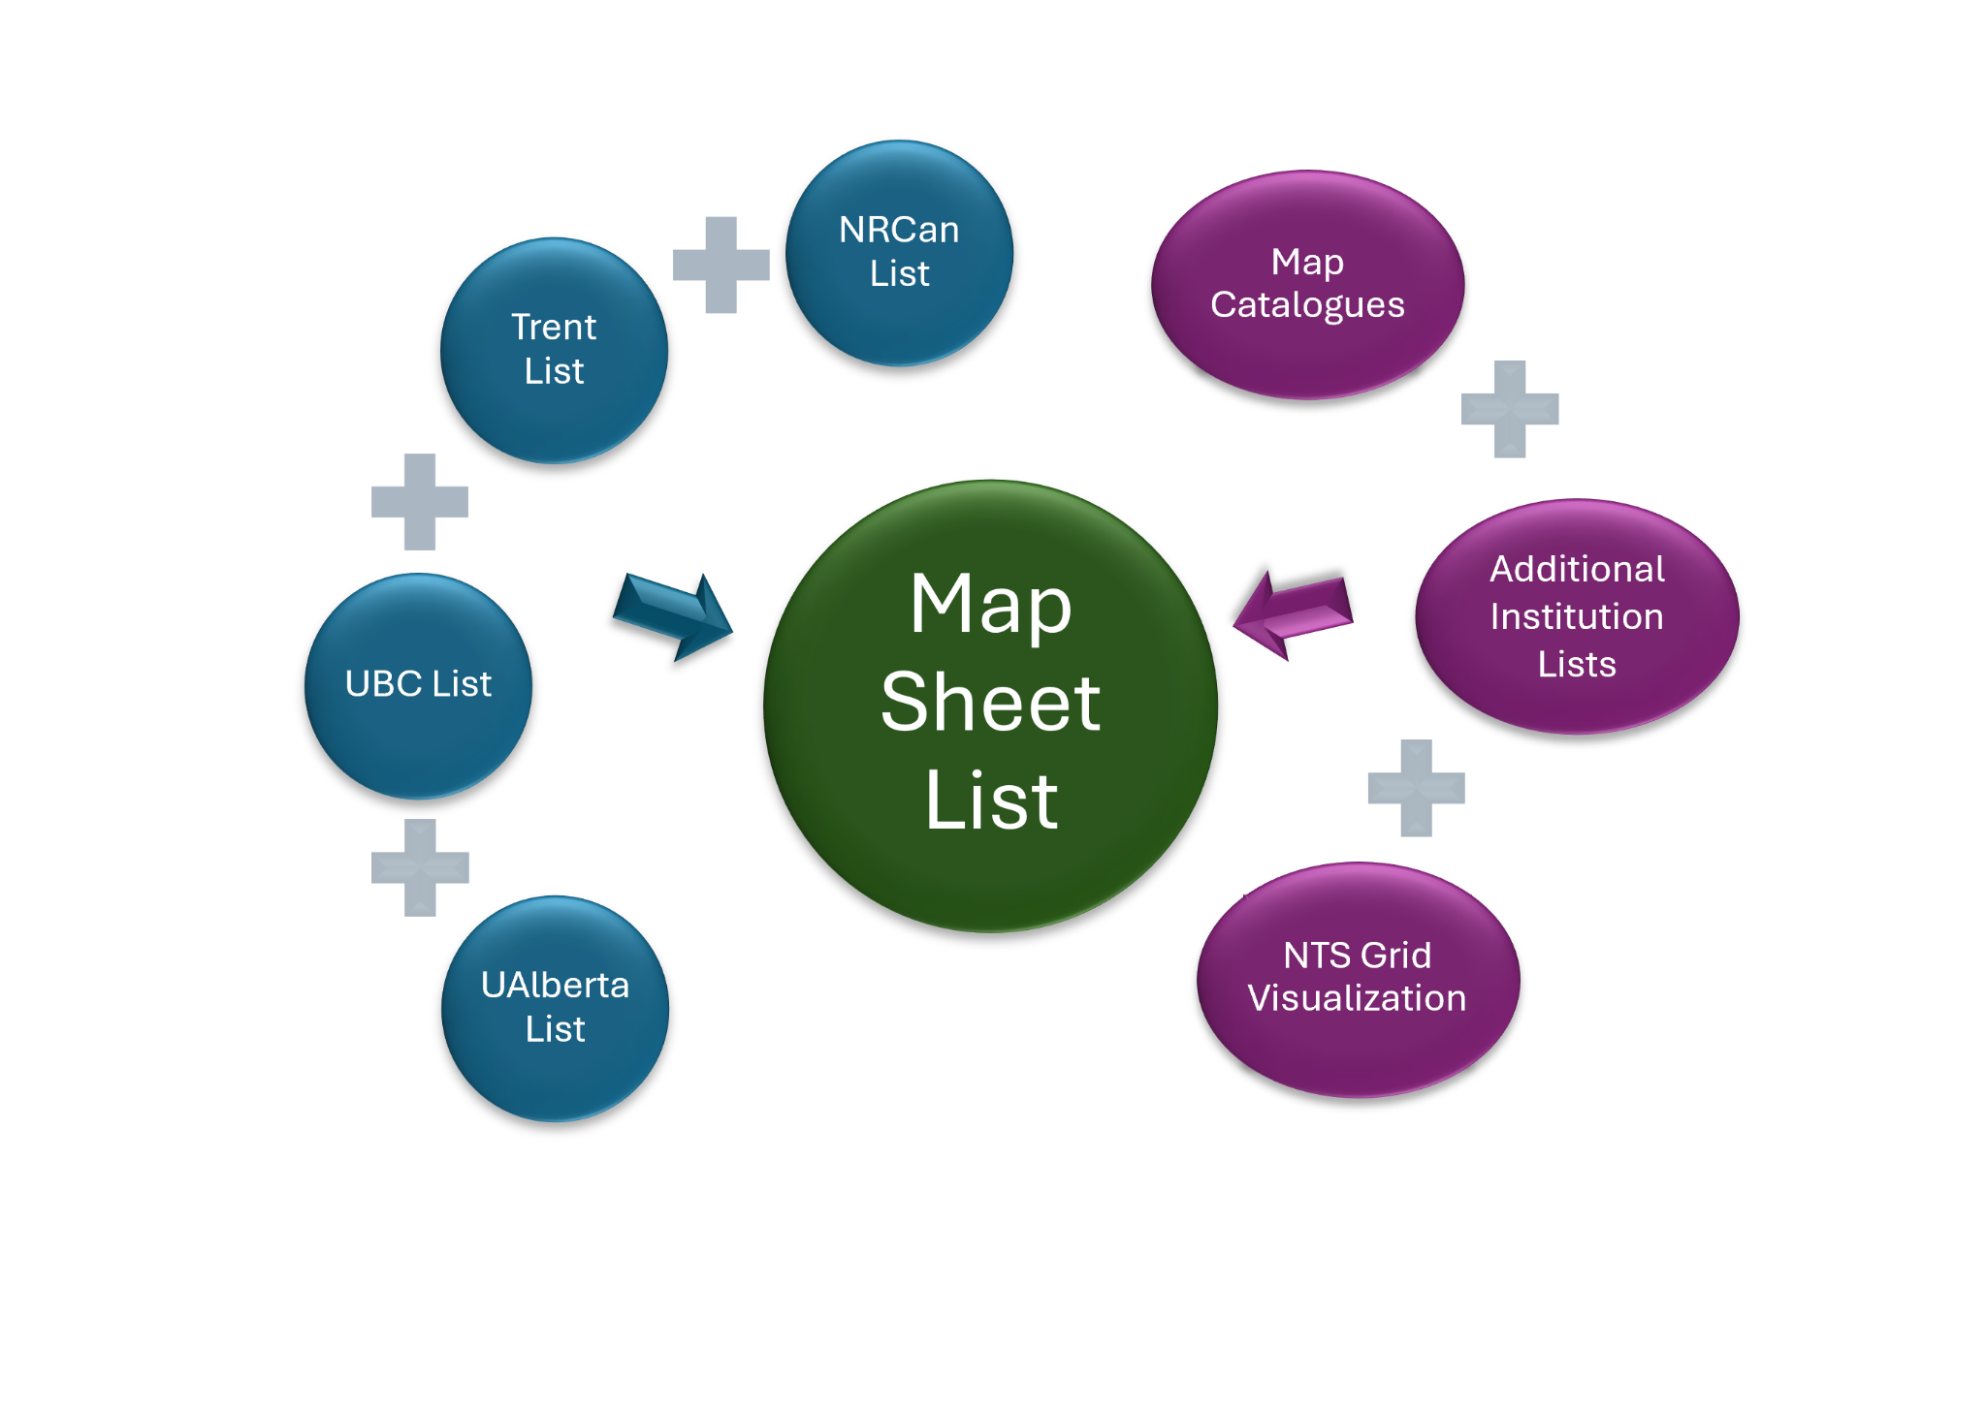
Progress & Methods
Late 2025: North/Nord Steering Committee approves the formation of this project
January 2026: group forms with representation from several academic libraries across Canada, plus NRCan
January 2026: Several OCUL-GEO colleagues respond to our call for inventories (thank you!)
February: work begins on the master inventory
March:
  Members begin compiling catalogues of these maps (see next slide)
  Sarah Reeser visualizes holdings by NTS zone (see following slide)

Slide 4
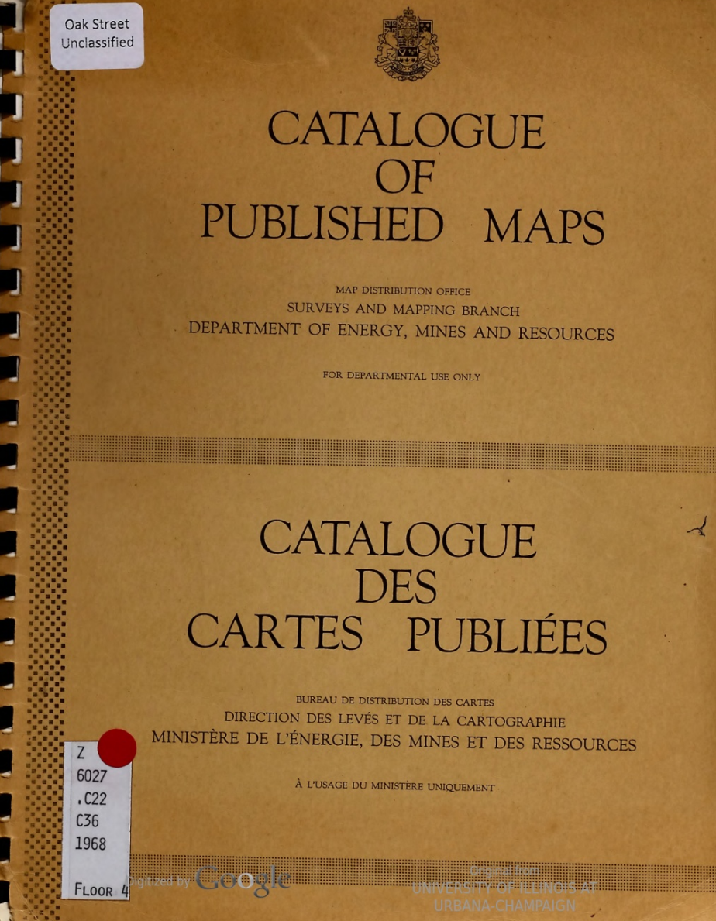
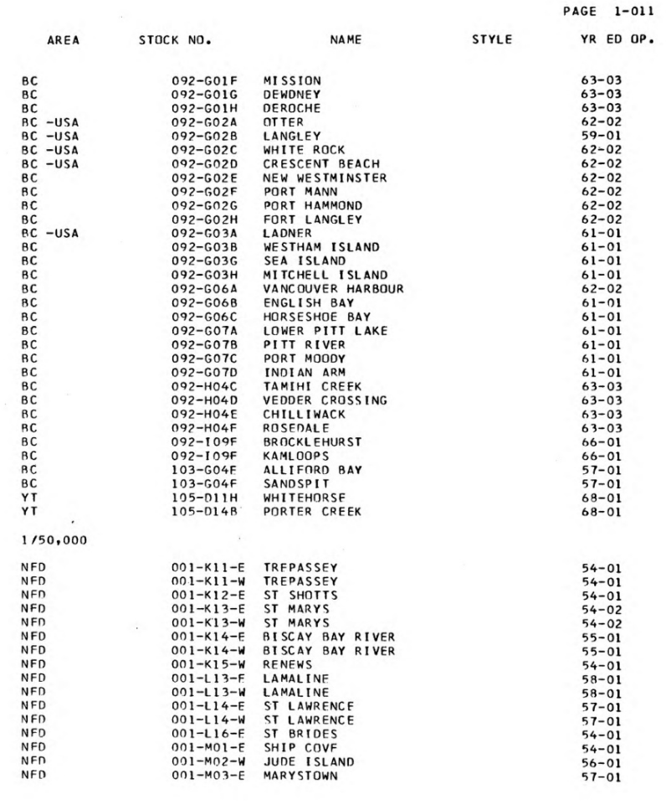

Slide 5
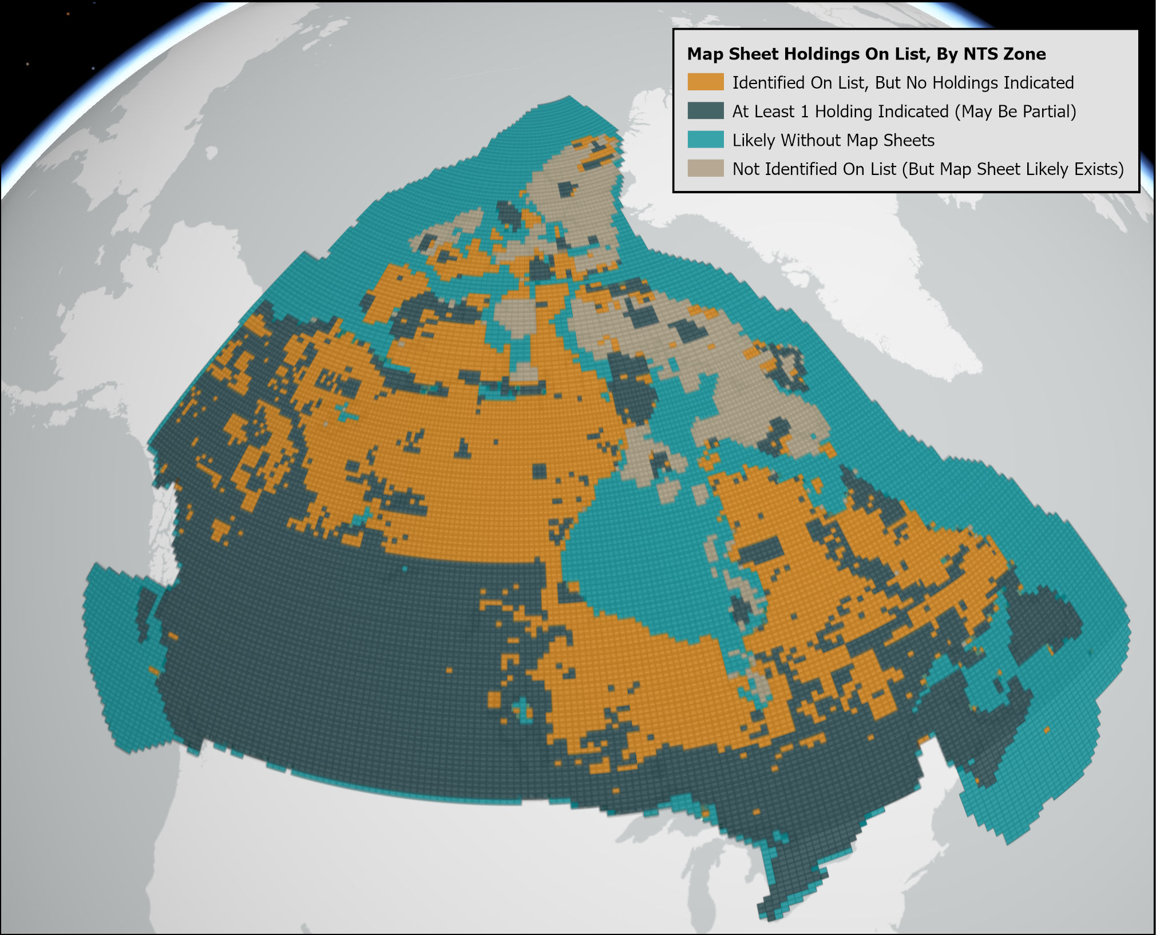
Information on zones with sheets likely to exist/likely without map sheets comes from NRCan’s GeoGratis Spatial Product Index

Slide 6
Next Steps
Immediate objectives
Gather additional inventories and catalogues
Finalize the master inventory
Some universities to update or begin local inventories
Questions
We are considering developing a “Stable Repositories of Map Collections” document which will highlight organizations & contact details where physical collections of maps are being retained in Canada (perhaps along with a summary of what those collections include). Would this be useful for our community?
Best practices around developing inventories of maps could be another output for our WG - are folks aware of resources which exist which they could recommend so that we don’t duplicate work?
If you happen to have an inventory of NTS 1:50k sheets that you have not shared yet, could you please consider sending it to us?
North: the Canadian Shared Print Network/
Nord: Réseau canadien de conservation partagée des documents imprimés

Slide 7
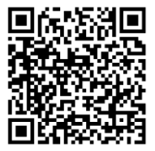
Maps Working Group Membership
& Contact Info
northnord_maps@coppul.ca
https://northnordsharedprint.ca/national-topographic-series-maps/
Julia Guy (University of Calgary)
Nick Field (University of Toronto)
Sarah Reeser (Scholars Portal)
Larry Laliberte (University of Alberta)
Dan Duda (Memorial University)
Nina Takahashi (Natural Resources Canada, Vancouver)
Francine Berish (Queen’s University)
Sheldon Armstrong (UBC)
Katya Pereyaslavska, North/Nord (ex officio)
Milica Ivetic, North/Nord (ex officio)

