Slide 1

The Future of Shared Print: Collaboration, Access, and Sustainability
Programs
June 17, 2026
Nicole Slipp
Atlantic Representative, North/Nord Steering Committee
The future of physical collection preservation in Canada lies in collaboration—moving from local ownership to shared responsibility to safeguard Canadian heritage.

Slide 2

North: the Canadian Shared Print Network/ Nord: Réseau canadien de conservation partagée des documents imprimés
Funded By:
Canadian Association of Research Libraries (CARL) – https://www.carl-abrc.ca/
Canadian Urban Libraries Council (CULC) – https://culc.ca/
Council of Atlantic Academic Libraries (CAAL) – https://caal.libcal.com/
Council of Prairie and Pacific University Libraries (COPPUL) – https://www.coppul.ca/ (Administrative Host)
Library and Archives Canada (LAC) – https://www.bac-lac.gc.ca/
Ontario Council of University Libraries (OCUL) – https://ocul.on.ca/
Partenariat des bibliothèques universitaires du Québec (PBUQ) https://pbuq.ca/

Slide 3
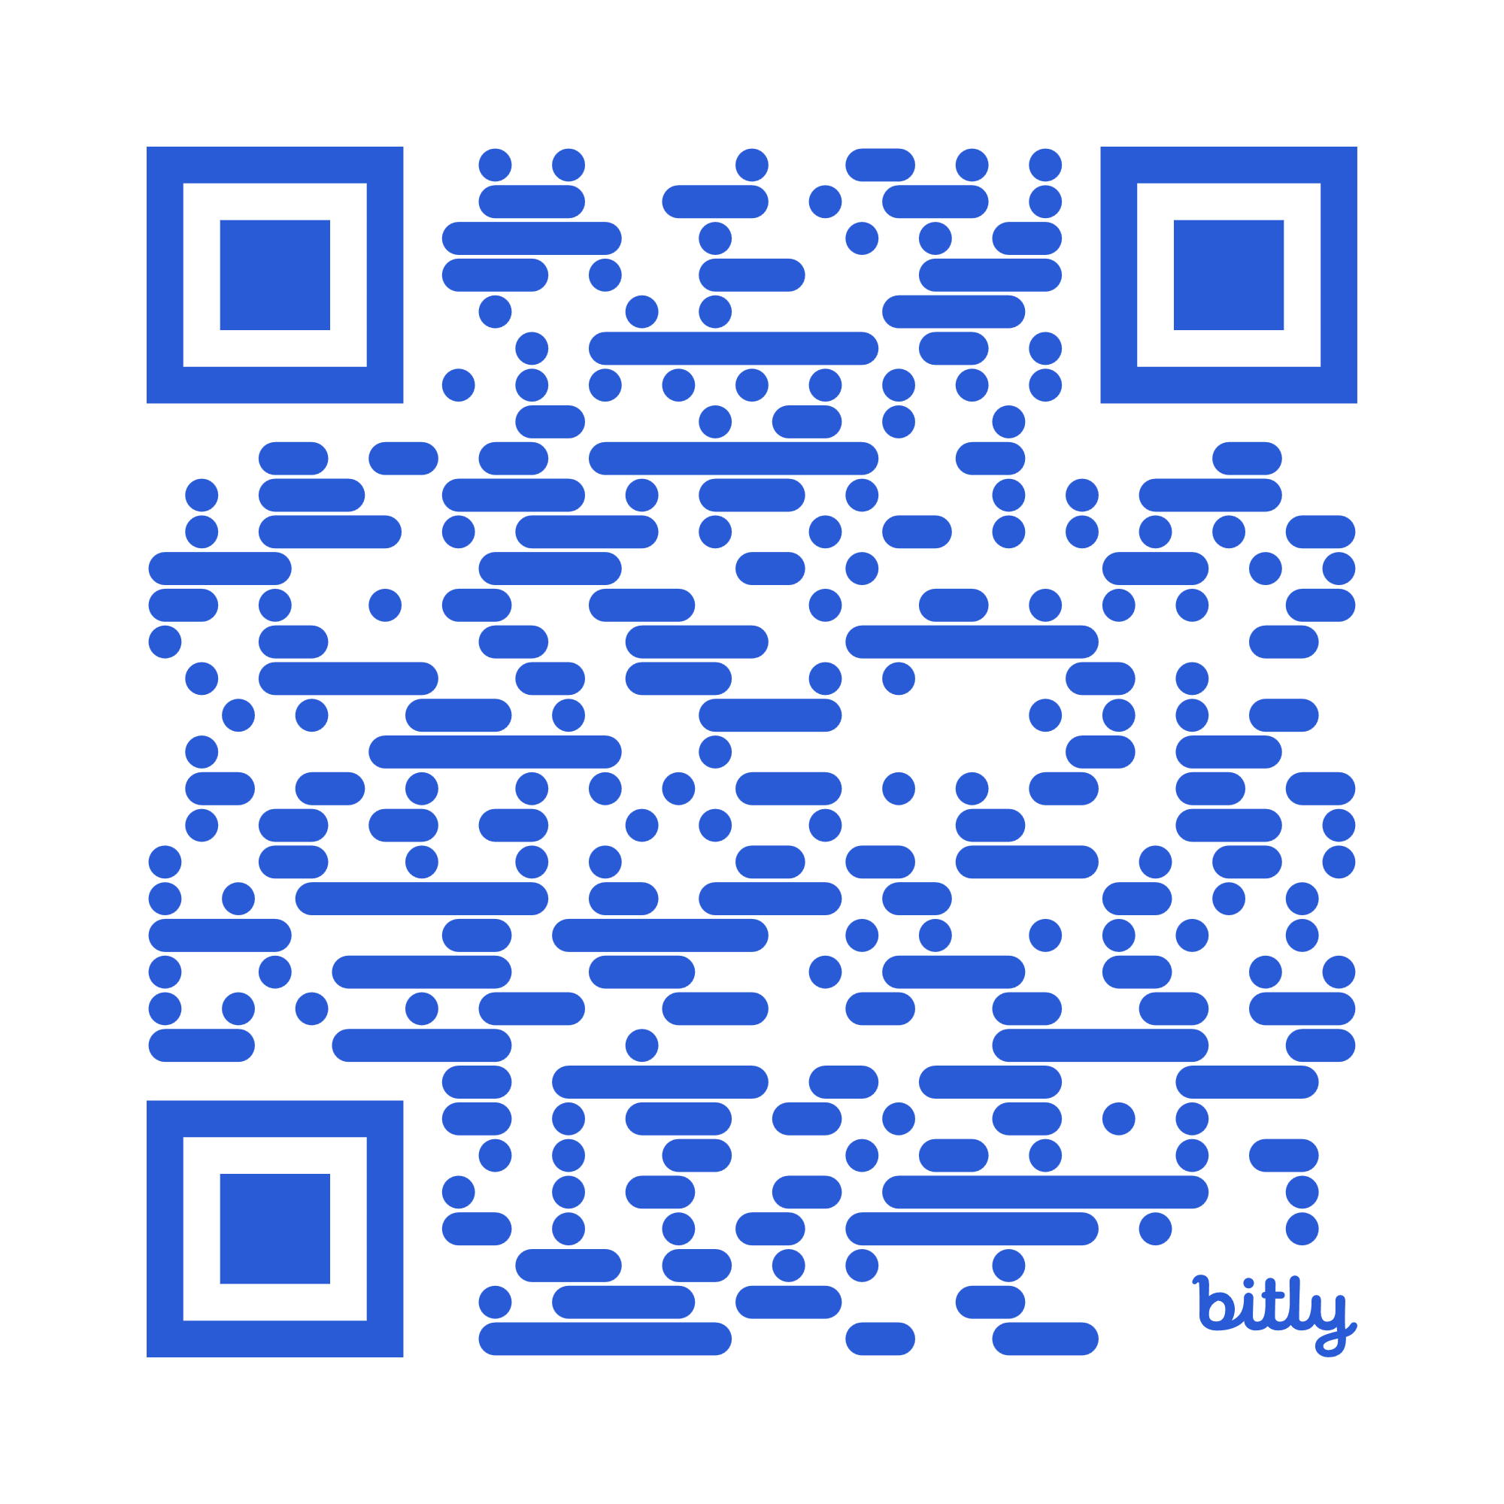
Polls!
PollEv.com/nicoleslipp

Slide 4
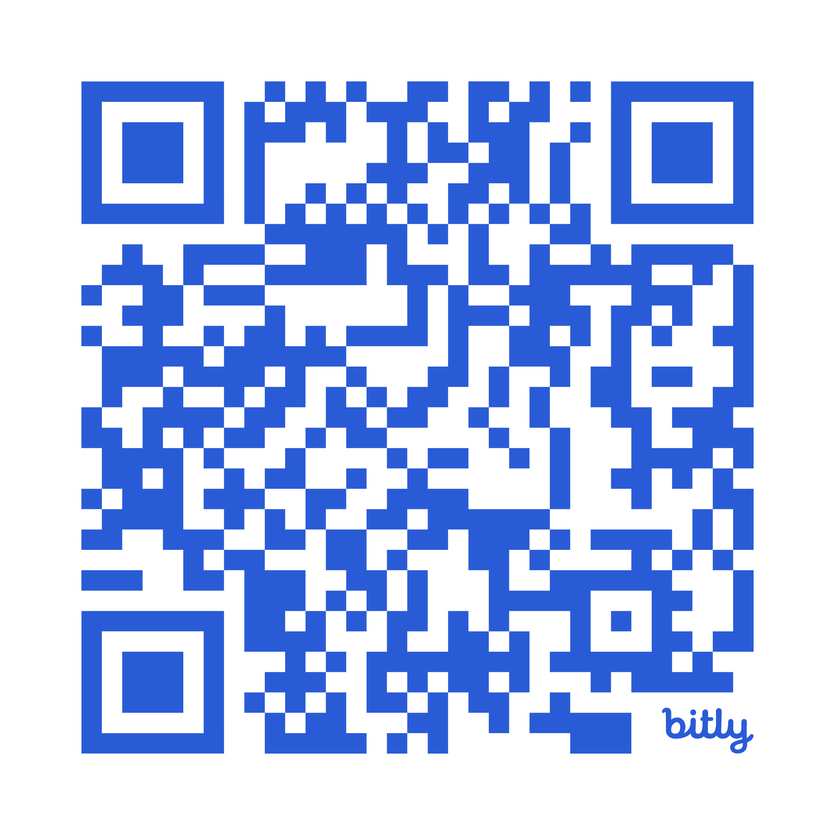
North: the Canadian Shared Print Network/ Nord: Réseau canadien de conservation partagée des documents imprimés
Founded in 2021, we are celebrating our 5-year anniversary this year!
Through collaboration among Canadian libraries, we ensure long-term access to physical library collections, balancing preservation and conservation activities with innovative and practical solutions like digitization to enhance accessibility.
A distributed, national approach to stewardship with a focus on protecting, preserving, and providing fair access to Canada’s scholarly and cultural record.
Governed by a Steering Committee & staffed by a Network Coordinator and Data Analysts
Coordination with regional & international shared print programs (Hathi Trust, West, East, EPICo, SPP etc)
https://northnordsharedprint.ca/

Slide 5
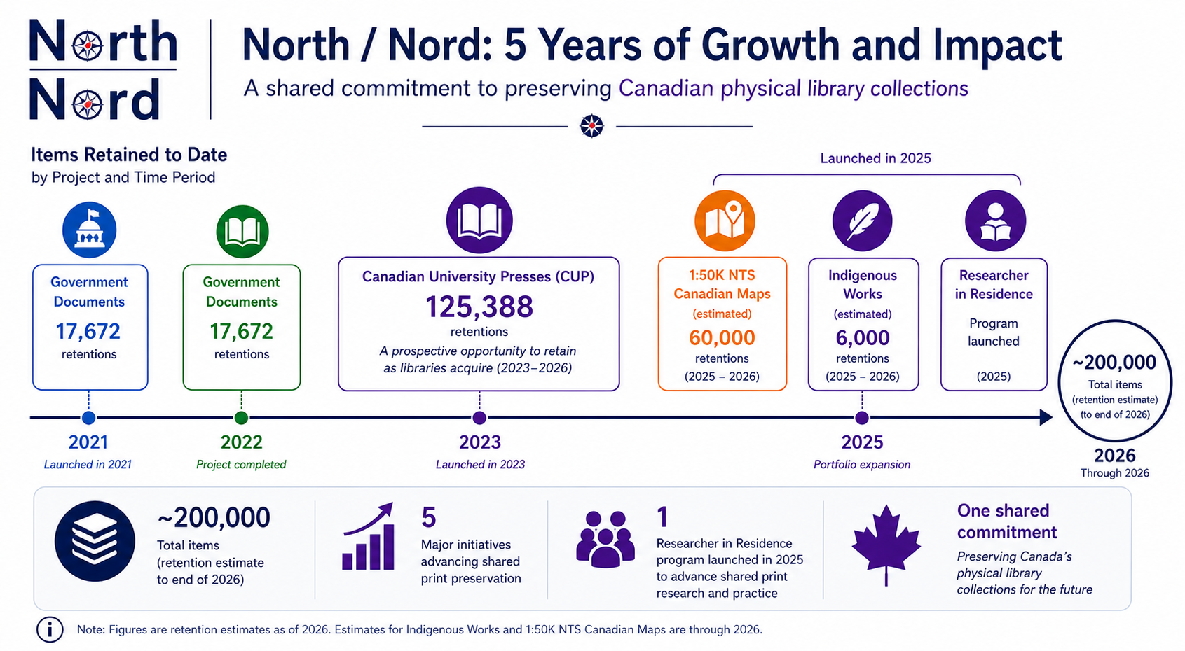
Program Trajectory & Archived Collections

Slide 6
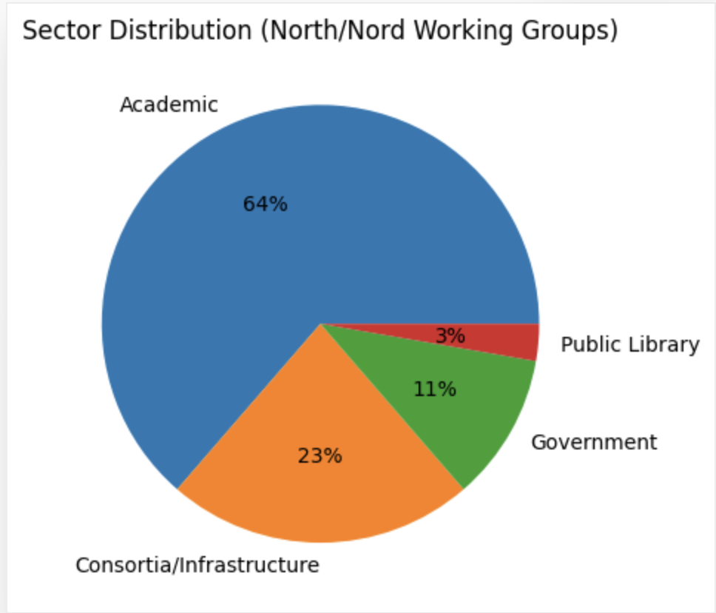
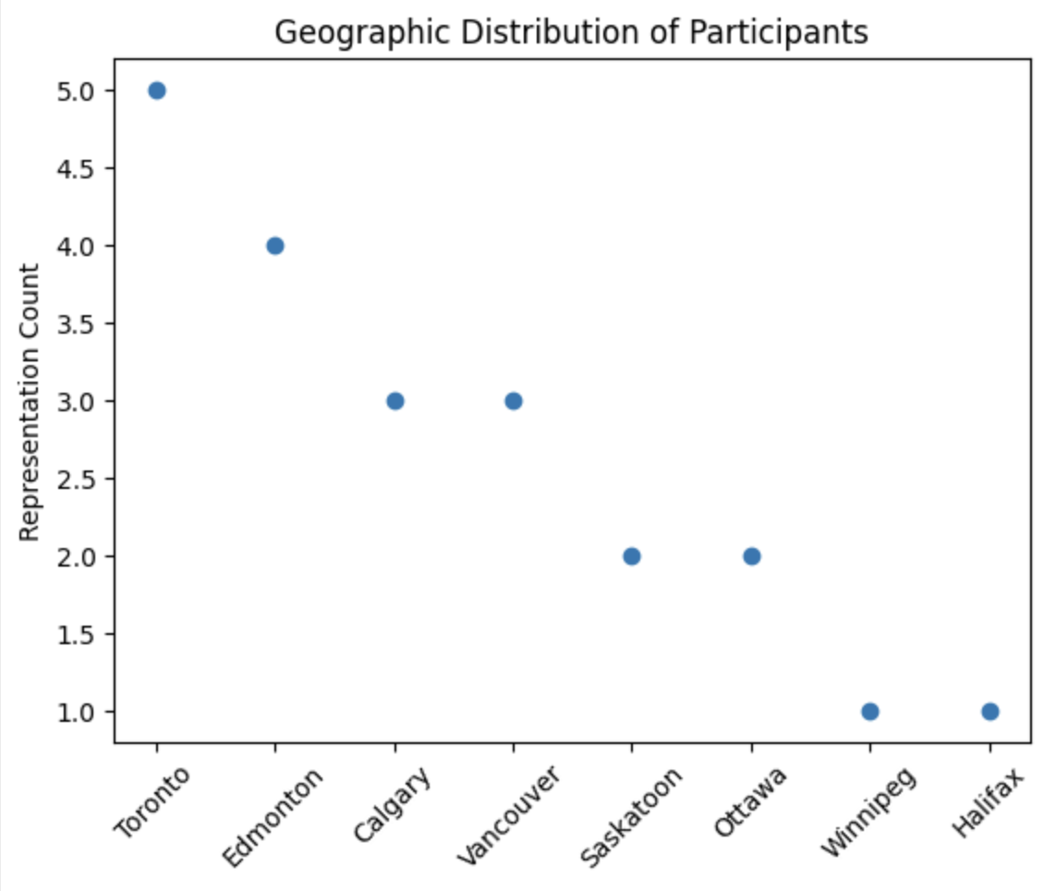
Program Infrastructure: Working Groups

Slide 7
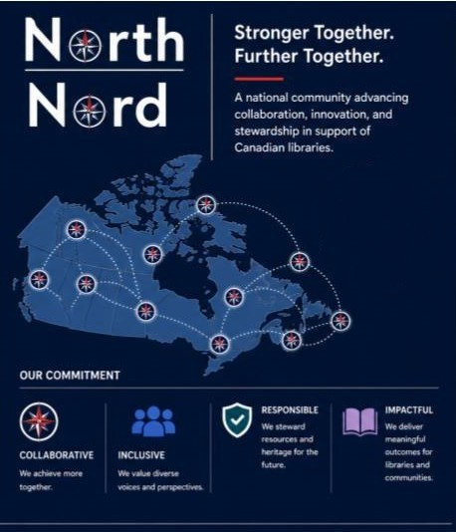
Membership

Slide 8
Atlantic Membership
CAAL-CBPA funds North/North and so all of its members are North/Nord members
CULC also funds North/Nord so all of its members are members of North/Nord, including
  Halifax Public Libraries
  NB Public Libraries
General membership in North/Nord is free! If your library is not already a member but is interested in joining check out the membership page of the North/Nord website
Project participation is decided by each member on a project-by-project basis, so you only contribute as you have interest and capacity

Slide 9
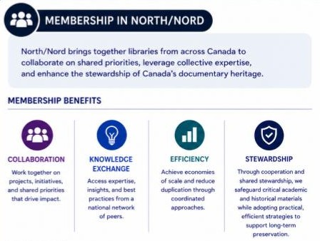
Benefits
Shared knowledge from national projects, e.g. the workflows from the CUP project
Preserved titles of national interest
Sharing knowledge between regional consortia

Slide 10
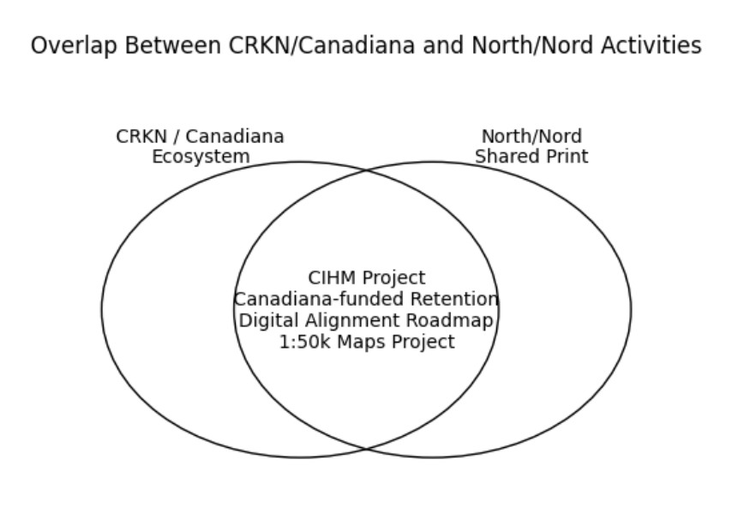
CRKN Collaboration
A project
  Delighted to work together with CRKN on a CIHM project
  Invitation to Retain Materials funded under Canadiana Collection Development Projects
  Digital Alignment Shared print Roadmap - with representative from CRKN
  1:50k topo map project - based on collection digitized in Canadiana (McGill).

Slide 11
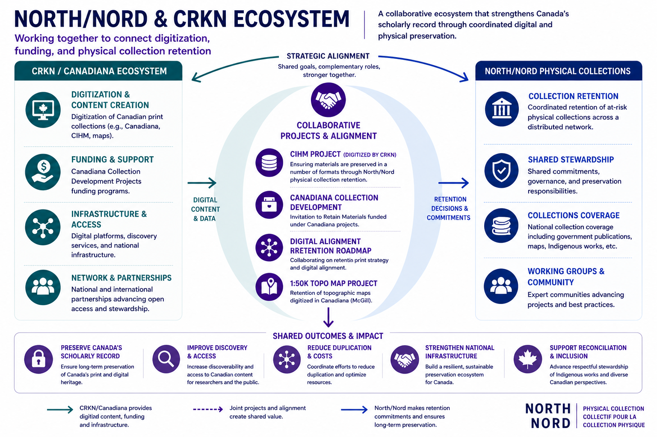
Collaboration with CRKN
Notes:
North/Nord and CRKN operate as complementary partners within Canada’s scholarly ecosystem, each advancing distinct but aligned mandates. CRKN’s leadership in digital infrastructure, content development, and access is strengthened by North/Nord’s coordinated approach to shared print retention and physical stewardship, together supporting a more integrated and resilient national preservation strategy.
Physical library collections are the foundational preservation layer and North/Nord coordinates collaborative, long-term retention of these materials nationally. This work intersects directly with national digitization and collection development efforts led by CRKN and Canadiana, forming a coordinated preservation ecosystem across both digital and physical domains.

Slide 12




Regional Shared Print Programs in Canada:
Preserving Canada’s physical collections is now a shared national responsibility, ensuring long-term access, sustainability, and resilience
COPPUL Shared Print Archive Network (SPAN)
Established in 2012
23 member libraries across MB, SK, AB & BC
Over 1.4 million retentions incl monographs, serials and maps
Keep@Downsview
Established in 2014
5 members + 1 associate member
Facility-based shared print program that operates out of UTL@Downsview
Over 200,00 items in our shared collection
Programme de conservation partagée des collections imprimées /
Shared Print Preservation Program
Established in 2021
15 French, 3 English universities
Circulating print books: 1,910,000 titles
Canadian serials: 27,909 titles
Distributed model: each institution retains items in their own collections

Slide 13
CAAL-CBPA and Shared Print
CAAL-CBPA (Council of Atlantic Academic Libraries - Conseil des Bibliothѐques Postsecondaires de l’Atlantique) formed a Working Group to discuss sharing print resources in April of 2025
The Working Group operates under the Collections Committee with members from each Atlantic province
The CAAL-CBPA Shared Collections Working Group’s first project was small: a single institution’s (Mount Saint Vincent University) retention commitment for the ERIC microfilm series
The Sub-committee has also drafted program agreements and gotten approval from the CAAL-CBPA board

Slide 14
Opportunities & Challenges
Opportunities
Expand the scope of shared “print” by experimenting with new formats and embedding one to two persistent library challenges into each project, generating solutions that benefit the collective.
Build on work developed by partner organizations, enabling the ongoing refinement and scaling of effective solutions and workflows.
Connect areas of shared need, foster collaboration, and open these conversations at a national scale.
Work towards alignment of digital and print as well as culturally sensitive approaches.
Challenges
Metadata: regardless of whether we rely on GreenGlass or develop inhouse collection analysis solutions, inconsistent metadata will continue to cause issues when de-duplicating records and working with collections.
Capacity: aligning long-term retention commitments with evolving member priorities and capacity constraints.
Sustainability: securing sustainable funding and staffing models that support shared print work into the future.

Slide 15
Thoughts on North/Nord?
What value could there be in North/Nord for your library in particular or our region generally?
Are there print resources at your library you worry about in terms of access or preservation?
What does success in shared print look like in the Atlantic region?

Slide 16
Thank you!
Nicole Slipp, Atlantic Representative, North/Nord Steering Committee
nicole.slipp@unb.ca

